Slide 1
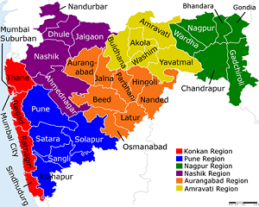
“Best Practices In Implementation
Of RKVY-PDMC in the state of Maharashtra”
Dt. 31st May 2023
Dr.K.P.Mote
Director Of Horticulture
Commissionerate of Agriculture
Maharashtra State,
Pune-411005

Slide 2
Micro Irrigation Potential & Area Coverage in Maharashtra
MH -(Area in lakh Ha)
Total Geographical Area | 307.70
Net Sown Area | 173.86
Net Irrigated Area | 32.52
Total Area under MIS From 1886-87 | 29.24
Area Covered Under MIS In last 7 Years | 9.77
Area (Lakh Ha)
Year
MH is pioneer state for implementation of Micro Irrigation Scheme from 1986-87.
Major Crops covered under Micro Irrigation : Grape ,Banana ,Pomegranate, Vegetables, Cotton, Sugarcane, Soyabean (Sprinkler)
Online Application Portal – E-Thibak (Year 2011-12 to 2019 -2020) & Maha DBT (2020-21 till Contd.)

Slide 3
Physical And Financial Progress Of Per Drop More Crop Scheme in last 7 Years
In 7 year | Area covered undaer MI (In Ha.) | Beneficiaries | Subsidy Disbursed (Rs. in Cr)
Total | 977548 | 1220302 | 3098.41
Area ( Ha)
Financial Year
MIS systems Installed in Last 7 Years which is now in working condition
Average 1.5 – 2 Lakh Ha area is covered Under MIS in Maharashtra under PDMC scheme.

Slide 4
Crop wise area covered under Micro Irrigation Scheme in last 7 Years In Lakh Ha.
Crop Name | Area covered Under MI (Lajh Ha) | % Contribution
Grape | 0.36 | 4
Banana | 0.35 | 4
Pomogranate | 0.36 | 4
Citrus Group | 0.56 | 6
Vegetable | 0.54 | 6
Cotton | 3.22 | 33
Sugarcane | 1.04 | 11
Other Crops | 3.34 | 34
Total | 9.77 | 100
Sugarcane & Cotton Contribute 45% area out Of Total area under MIS.
% Area under MIS in Horticulture Crop is increasing yearly.
Cotton under MIS –In Vidarbha & Marathwada Region has helped farmers for higher Yields & Profit.
Area under Sugarcane in Western Maharashtra is increasing .
All Crops are covered under MIS in MS.

Slide 5
Implementing Agency Structure
Principal Secretary (Agril. )
Commissionerate Of Agriculture (COA)
Director Of Horticulture(DOH)
Divisional Joint Director (JDA)
District superintendent Agriculture Officers (DSAO)
Subdivision Agriculture officers (SDAO)
Taluka Agriculture Officer (TAO)
SLSC Meeting,
Administrative Approvals
Implementation Agency.
Overall Monitoring Of The Scheme
Registration Of MI Manufactures
Guidelines
Monitoring & Coordination With Districts.
Scheme & Fund Monitoring
Dealer Registration
Material & Service Centers Monitoring.
Fund Disbursement.
Field level Monitoring
Field Level Monitoring
* Scrutiny, Presanctions,
* Spot Verification & Recommendation Of Subsidy through AS,CAO,TAO
Dedicated Officers For Monitoring System/Scheme.
Effective Utilization if IT recourses.
Timebound for all Works & Process.
Communication Effectiveness & Frequency of Meeting & Reviews with Stakeholders.
Frequent trainings to District & TAO level Officers for Better implementation of Guidelines .
Continuous communication with GOI for suggestion/issues if any.

Slide 6
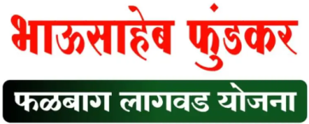
RKVY-PDMC & State Top Up Subsidy Schemes in MH
RKVY-PDMC+CMSAIS
POCRA (World Bank Project)
Birsa Munda Krishi Kranti Yojna
Dr.Babasaheb krishi Swavlamban Ambedkar Yojna
Atal Bhujal Yojana
Bhausaheb Pundkar Yojna
RKVY -PDMC
Big farmer- 45%
Small Farmer 55%
CMSAIS –State
Top Up Subsidy
Big farmer- 30%
Small Farmer 25%
POCRA
Big Farmer 75%
Small farmer- 80%
Farmers of 5142 Villages From Marathwada & Vidharbha having land holding below 5 ha are applicable.
Separate Project Director at Mumbai
ST farmers will get 90% Subsidy.
Benefit is given through MAHADBT Portal automatically for ST farmers.
SC farmers will get 90% Subsidy.
Benefit is given through MAHADBT Portal automatically for ST farmers.
100% Central Govt Funds.
75%-80% subsidy for 1443 Villages from 13 Districts
Benefit is given through MAHADBT Portal.
Applicable for area 0.10 ha in Konkan & 100% subsidy for MIS for selected beneficiaries under this scheme.
Max Area under MIS can be 6 ha.
Sr.No | Scheme Name | Small & Marginal (Center Share +State Top Up Share ) | Big farmers
1 | RKVY-PDMC + CMSAIS | 80 %(55+25) | 75 % (45+30)
2 | RKVY-PDMC + Atal Bhujal (For Selected Villages) | 80% (55+25) | 75% (45+25)
3 | PoCRA (A World Bank Project) | 80% (World bank) | 75% (World bank)
4 | RKVY-PDMC + BIRSA Munda Krishi Kranti Yojna (For ST Farmers) | 90%(55+35) | 90% (45+45)
5 | RKVY-PDMC + Dr. Babasaheb Ambedkar Krishi Swavlamban Yoajna (SC Farmers) | 90 % (55+35) | 90% (45+45)

Slide 7
MahaDbt Portal & Documents
Basic Documents Required for Subsidy Process
Sr.No | Doccument | Remark | Stage
1 | 7 – 12 | For all Schemes | After Lottery Selection/Before Presanction
2 | 8 A Utara
3 | Parishishta 7 a / 1
4 | Caste Certificate | For Birsa Munda & Dr.Ambedkar scheme
5 | Common land Undertaking | Applicable for common land Holders only
6 | Common water availabilty undertaking | Applicable for Common water Source Holders only
7 | Farmer Invoice | For all Schemes | After Presanction & Installation is Done
8 | Graph
Photo /Aadhar/ Bank details are Required in Few Schemes.
MAHADBT PORTAL:
https://mahadbtmahait.gov.in/login/login
Guidelines-State
http:40.80.81.88/mahdrip/ethibak/index.php
Operational Guidelines (GOI) 2021
https://pmksy.gov.in/microirrigation/Archive/GuidelinesMIRevised250817.pdf
DBT model successfully implemented through Maha DBT Portal since FY 2020-21
Farmers can apply all Major Schemes (14+) through Maha DBT Portal.
Paperless Work (No hard Copy)
7

Slide 8
RASHTRIY KRISHI VIKAS YOJANA –PER DROP MORE CROP
MAHADBT Features - Web Portal
From 2020-21 all DBT schemes of department including PDMC are implemented through newly developed “ Maha- DBT Portal”
Main Features
Single Application with Multiple components benefits .
Software based lottery system used for transparent selection of beneficiaries.
Weekly lottery selection of new beneficiaries against cancelled applications.
From Submission of application to subsidy Disbursement all processes are online & Paperless
After due date , Auto Cancellation & rejection of applications facility is available
Pendency at every desk is monitored weekly & scrutinized through portal.
The status of application communicated to beneficiary via SMS
For Grievance redressal of dept officers & farmers, help desk is created
Subsidy is to be disbursed to the farmer’s bank account which is linked to Aaadhar number.
MAHADBT Portal & PFMS integration is under progress to avoid delay in payment.

Slide 9
MAHADBT-Work Flow
Online Farmer / FPO / Org / Group Regi. on MahaDBT Portal
User ID & PWD Creation
AADHAR Number is mandatory (OTP / Biometric)
Personal Info, Farm Info, Crop Info, Family Info, Water Source Info, etc. by Farmer (Login ID, PWD)
Selection of Scheme / Schemes and Preference of Farmers is given
Application Submission with Rs 22/- + GST Rs 3.60/- fees (Per Application)
Computerized Lucky Draw is done & selected Farmers are informed by SMS
Selected farmers to upload the documents online in soft copy only (No Hard Copy is needed)
(7+3 =10 Days)
Application and Documents Scrutiny by Govt. Officials (multilevel)
PreSanction Given online and Farmers are informed by SMS
Installation and online Invoice Upload by the farmer within stipulated time
(25+5 =30 Days)
Subsidy Credited to Farmers Account through PFMS by District Sup.Agril.Officer (DSAO)
Average -60 Days
Spot Verification, GeoTagging Remarks given through portal/ MahaDBT app. Hard Copy of Document checked

Slide 10
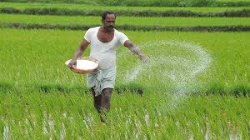
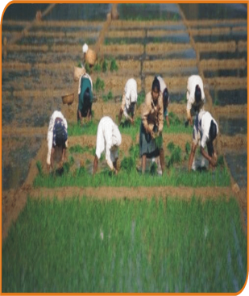
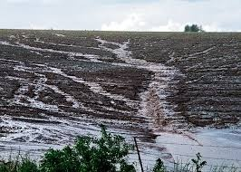
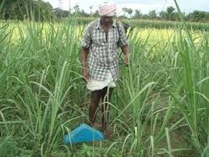
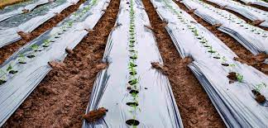
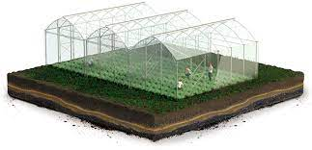
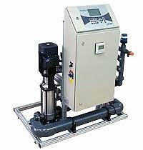
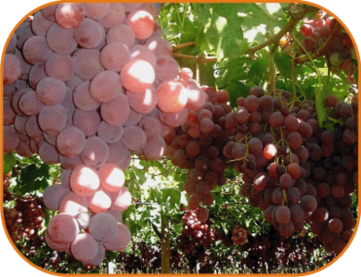
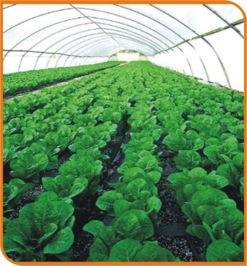
Benefits Of Micro Irrigation In Maharashtra:
Flood Irrigation
Drip / Sprinkler Irrigation
High Water Use Efficiency
Fertilizer Efficiency 85%-90%
Labour Cost Saving
Increase in Area under MIS
Undulating land
Energy Saving
Runoff
Pesticides/Weed
Saline Water Usages
Mulching
Controlled Agriculture
Automation
Quality Product
Timely Return on Investment & Peace Of Mind to farmer
Increase in yeild

Slide 11
Key Factors Affecting Implementation of Micro Irrigation Scheme
Corrective Activity taken for Implementation From MH
Awareness of MIS
Scheme Campaign ,Pamphlets , Sign Boards in Taluka & Dist. ,Village Level
Involvement of KVK. Farmer meetings. Farmer trainings.
Social Media & Print Media use .Press Notes etc.
After Sales Service
Yearly 15 Days Compulsory After sales service campaign from MI Manufactures & Dealers
Close Monitoring for last 3 Year farmer service records.(1 lakh farmers/Year)
Farmer awareness & Toll-Free number display in Service Centers & Online Portal
Quality Control
Sample Collection of Major Components on Yearly basis & Review
Random Field level Cross checking of MI fields. BIS,CML Checking & “Moka Tapasani”
Farmer Feedback & Resolution in Time.
Scheme Monitoring
Daily Basis Monitoring of various stages & Progress by all.
Close review of Issues & corrective actions.
Transparent Mechanism for Farmer Selection
Funds & Process Management
Timely Submission of AAP. SLSC –MOM submission.
Support from GOI / State Finance for Fast process.
Compliance of GOI process & District to COA level successful implantation of SNA & PFMS Process.
Execution of Scheme in Time.
That’s Why Maharashtra is only state to get all 4 Installments.

Slide 12
State Initiatives For Implementation Of PDMC Scheme
MH-GR For Running all Agril Schemes From 1st April.
Registration & Renewal Of MI Companies in Time .
Close Monitoring of Funds & Progress.
Promotion of Chief Minister Agril.Sustainable Irrigation Scheme.
Special Campaign For SC/ST Farmers.
Coordination with Stakeholders –Irrigation Association Of India, Dealer Association.
Regular Trainings to Stake holders.
Material Supply Management & Monitoring
After Sales Technical Services Campaign once in a Year (15 Days)
Quality Control
Success story Creation.
Promotion Of RKVY-PDMC Scheme through Media
Promotion of Scheme on Department YouTube Channel.
Banners & Posters in all District & Taluka Level Office
Coordination With Research Institutes, Progressive Farmers.
Grievance management & IT cell Coordination.

Slide 13
Key Achievements
Year Round Implementation of Scheme
Timely Fund availability from Center & state
Reduction in Application to Subsidy Disbursement time.
1st State to successful implementation of SNA Process and 1st state in country who got all four installments from GOI in 2022-23
Successful After sales Service Campaigns.
Area under Horticulture Crops has been Increased.
Study Committee For Better Implantation of Scheme.
Effective Use Of Technology.
Recognition From State Govt.

Slide 14
Scheme progess on Mahadbt portal
Scheme | Stage | YEAR
 |  | 2020-21 | 2021-22 | 2022-23 | Total
RKVY -PDMC | No Of Application received | 251395 | 656872 | 861836 | 1770103
 | No Of application selected in Lottery | 251395 | 656872 | 566807 | 1475074
 | Farmer Document Uploaded for Presanction (No) | 87868 | 231642 | 197823 | 517333
 | Presanctions Given (No) | 87843 | 231557 | 195996 | 515396
 | Invoice Received (No) | 87843 | 230272 | 186472 | 504587
 | Physical Verification Done(No) | 87842 | 230122 | 170953 | 488917
 | Subsidy Released Beneficiaries (No) | 87605 | 230090 | 165746 | 483441
 | Subsidy Released (Rs. in Cr) | 163 | 575 | 360 | 1098
 | Area covered under micro irrigation in lakh ha. | 0.69 | 1.89 | 0.93 | 3.51
CMSAIS | Available Grant (Rs. In Cr.) | 333.38 | 200 | 204 | 737.38
 | Subsidy Released ( Rs. In Cr.) |  |  |  | 375.82
 | No of farmers benefitted |  |  |  | 282891
Atal Bhujal | Available Grant & Released ( Rs. In Cr.) |  |  |  | 20
 | Subsidy Released ( Rs. In Cr.) |  |  |  | 18.25
 | No of farmers benefitted |  |  |  | 18109

Slide 15
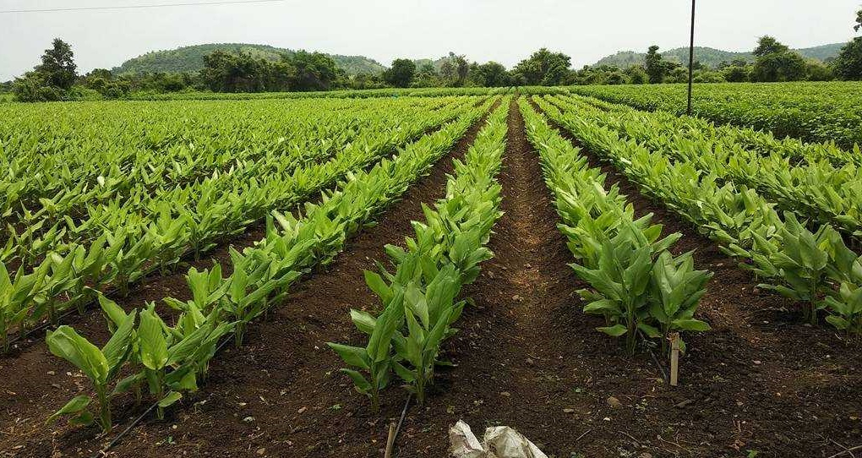
Way Forword
PFMS Portal & MahaDbt Portal Integration
Online Manufacture & Dealer Registration
Online Material Management System
Demand Base Benefit for MIS Subsidy.
(Farmer who wish to Install MIS System Will Get benefit)
( Magel Tyala Thibak)
Dashboard for Public Domain

Slide 16
Suggestions :
Guidelines:-
1) Detail Guidelines For NGO/Institutional Subsidy Process
2) Subsidy For Automation
3) Cost Norm selection Criteria on Lateral Spacing.
4) Cost norm for Minimum area up to 0.10 ha for drip & 0.20 ha for Mini sprinkler.
5) To allow Portable sprinkler Cost Norm of 75 mm for area up to 0.40 ha.
6)Allow use of BIS 4984 HDPE Pipe for Mini & Micro Sprinkler System.
7)Use of Plastic Nozzle and Riser for Portable sprinkler.(BIS 12232)
8)Guideline for Composite Tax Bills.

Slide 17
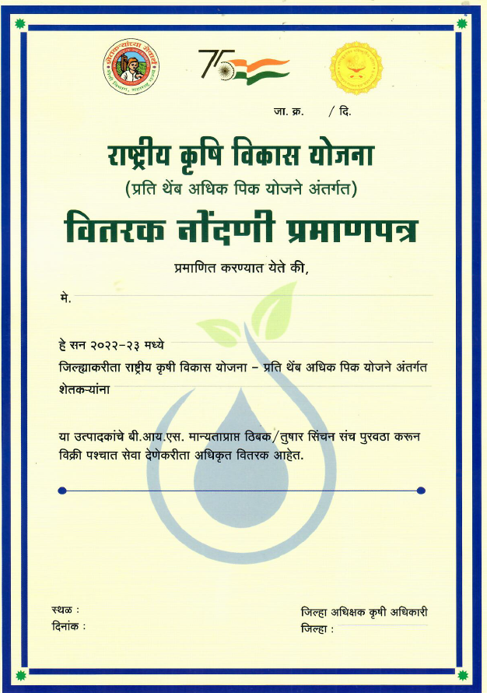
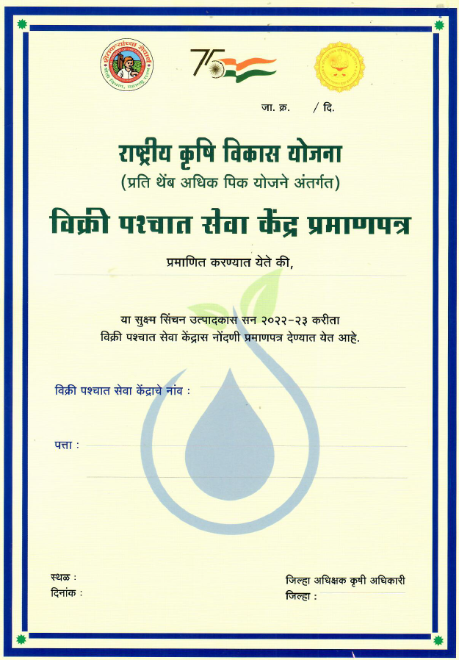
Activity:
After Sales service Center Certification & Registration Certificates at Each Dealer Outlet.
Service Center Display Board On Authorized Service Centers

Slide 18
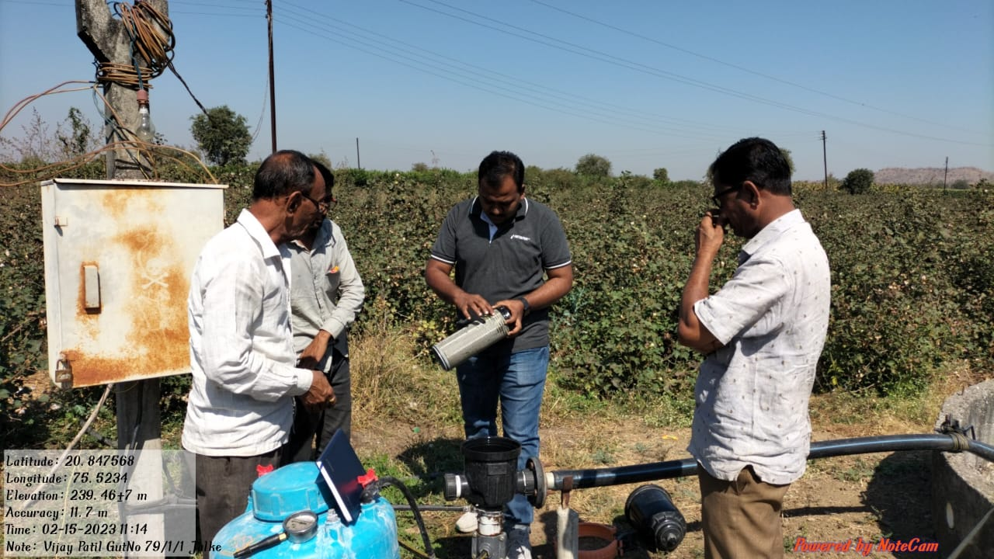
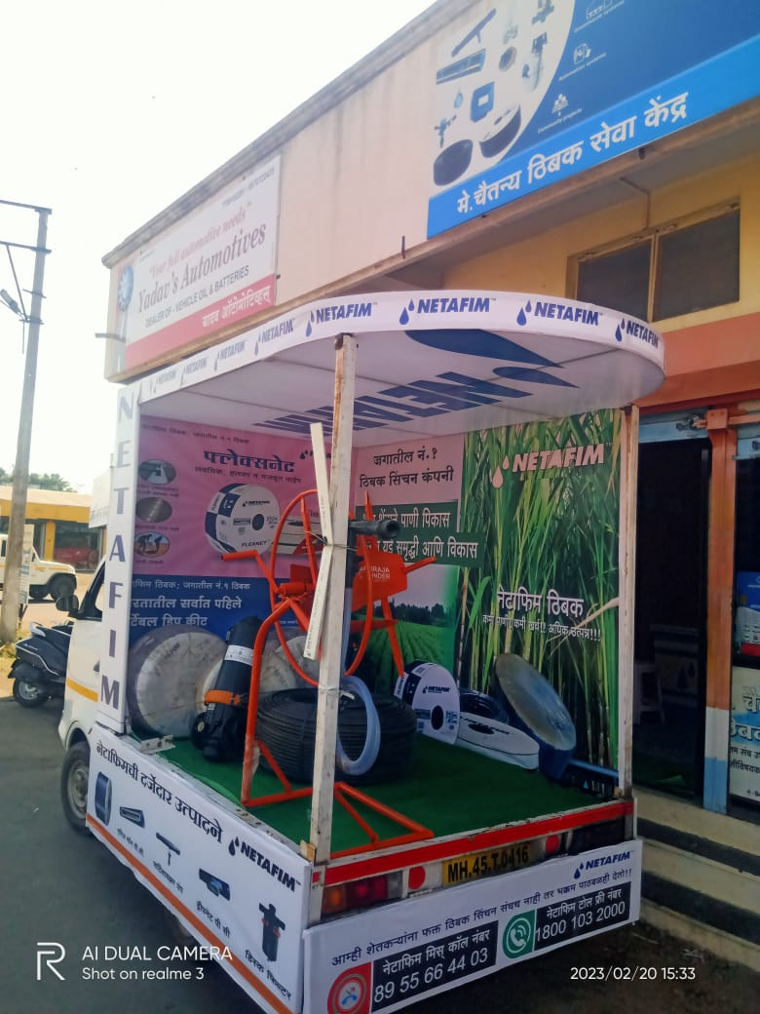
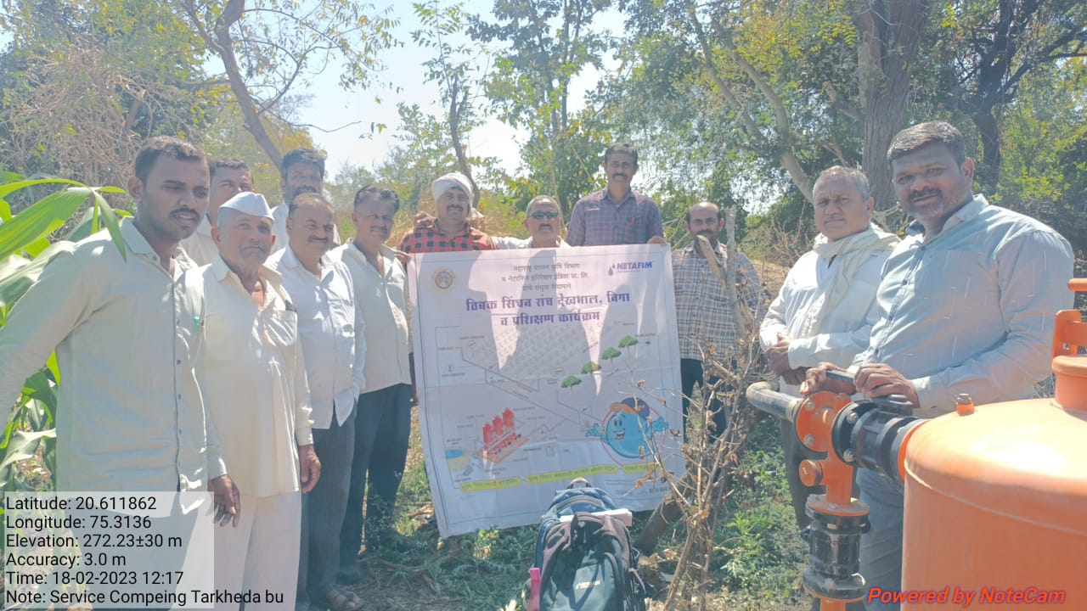
Service Campaign -Activity:
Activities During After sales Service Campaign
Farmer Meetings
Farmer Trainings
Van Campaigning
Acid Treatment
MIS Servicing.
Banners /Posters Display
Maintenance Manual Distribution
Service Center Checking
Social Media campaign.
Involvement Of all Stakeholders in Campaign
FY- Year | Service Campaign Days
2019-20 | 15
2020-21 | 15
2021-22 | 15
2022-23 | 15

Slide 19
Campaign

Slide 20
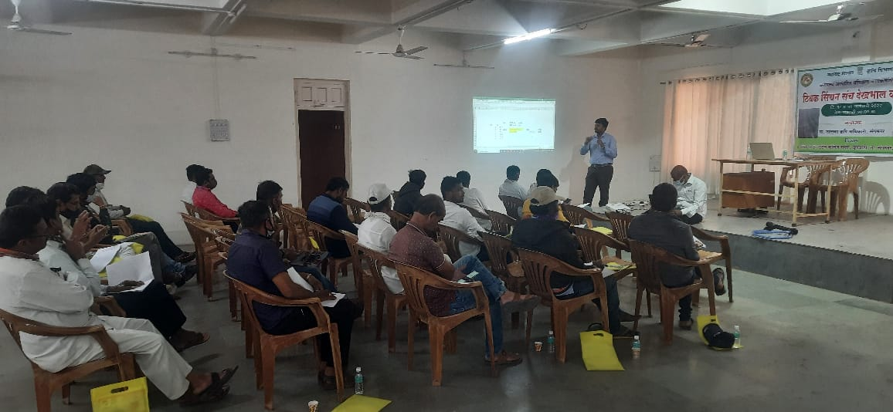
RASHTRIY KRISHI VIKAS YOJANA –PER DROP MORE CROP
In House Farmer Trainings

Slide 21
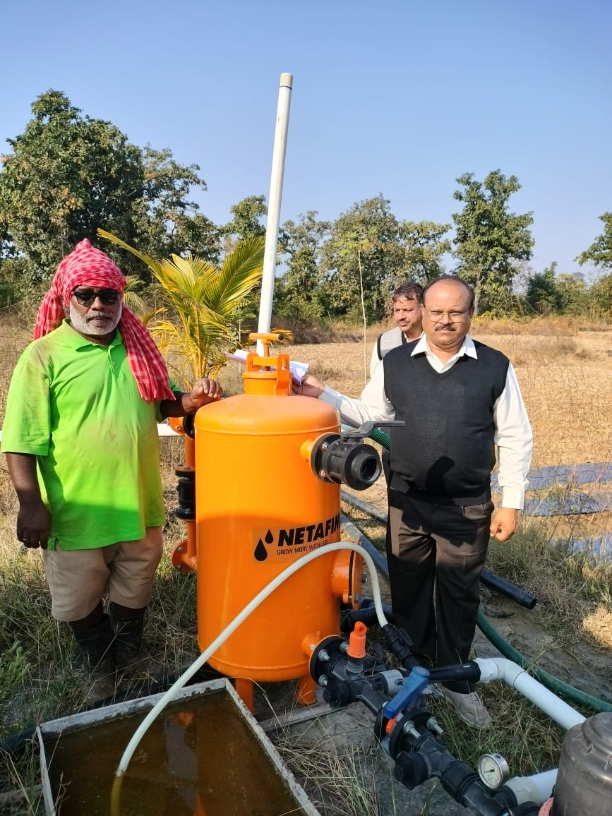
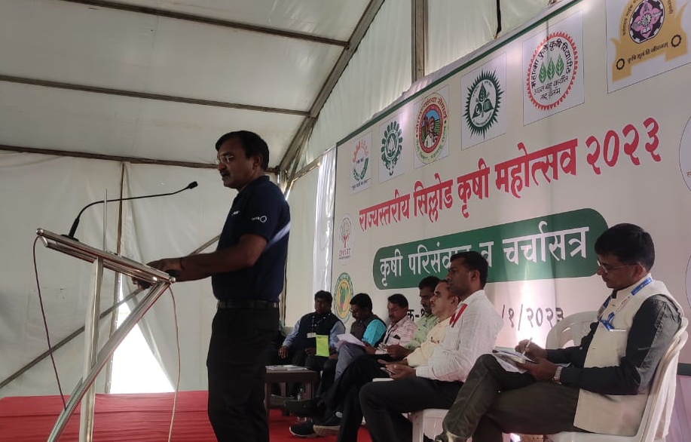
Campaign
Filed Visit By Dr.K.P.Mote (DOH) at Remote area
(Gadchiroli)
Extension On MI In Agril Exhibitions at Sillod 2023

Slide 22
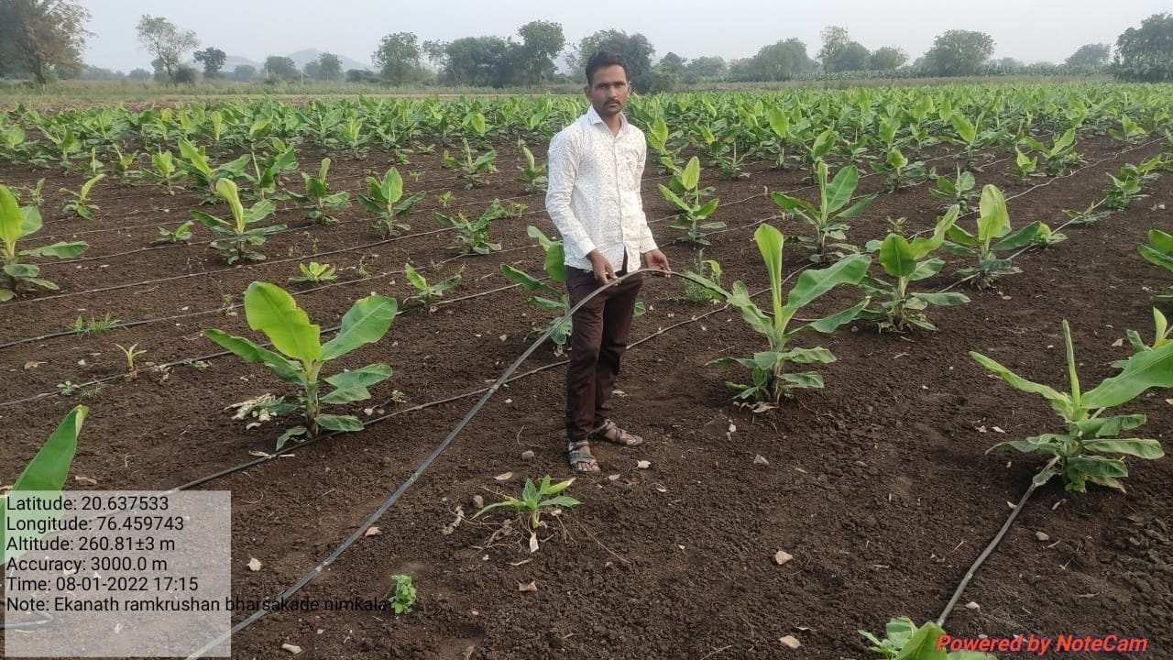
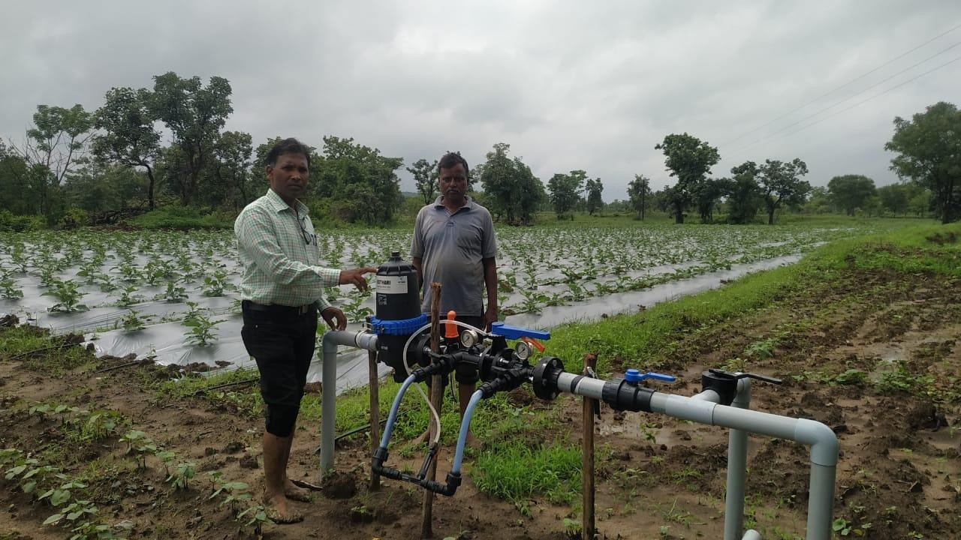
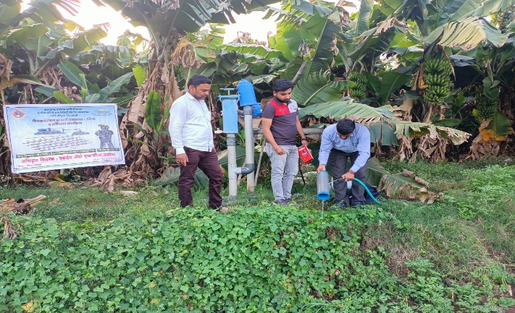
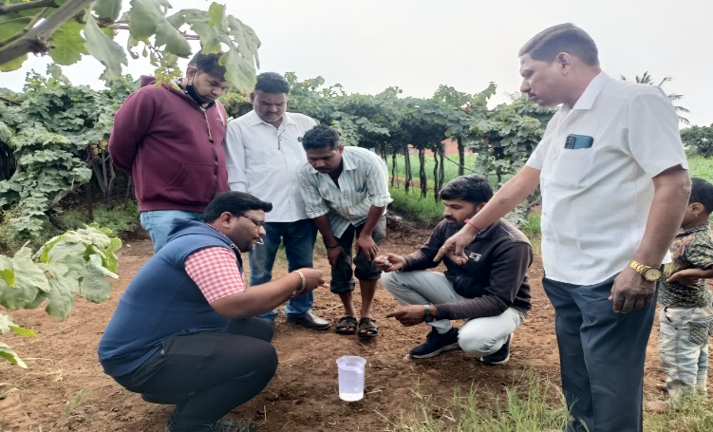
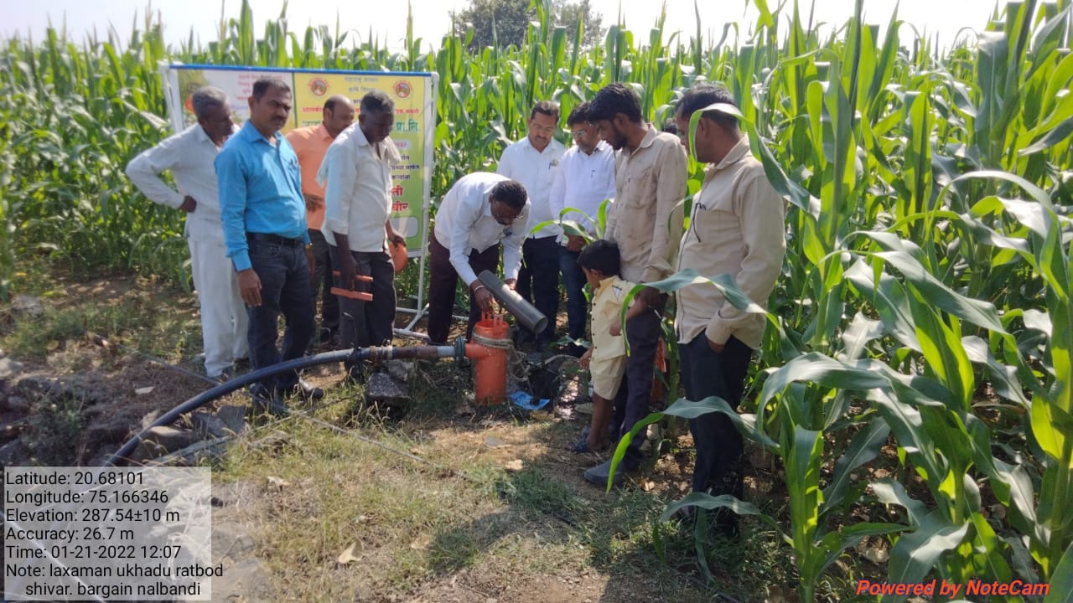
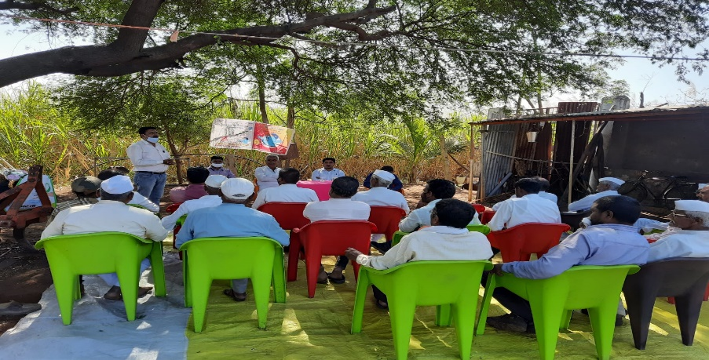
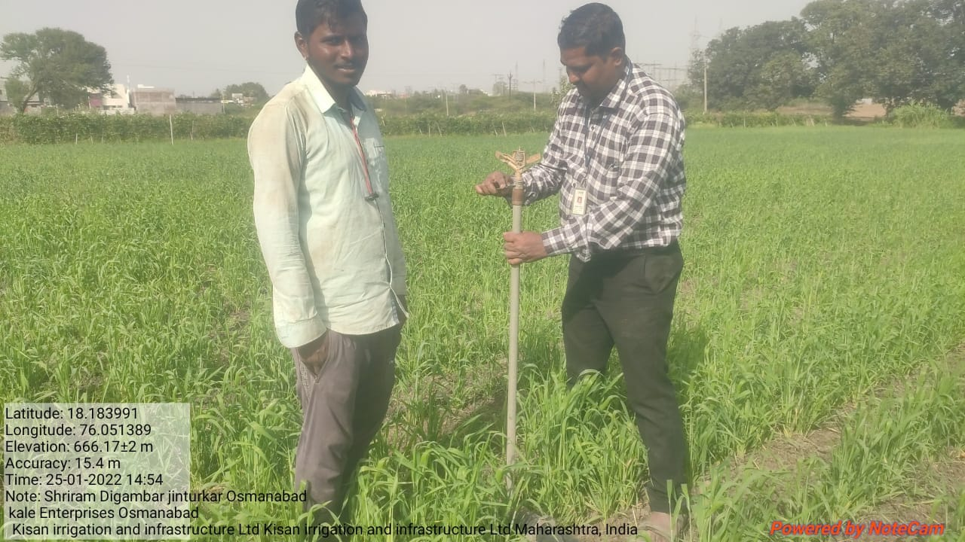
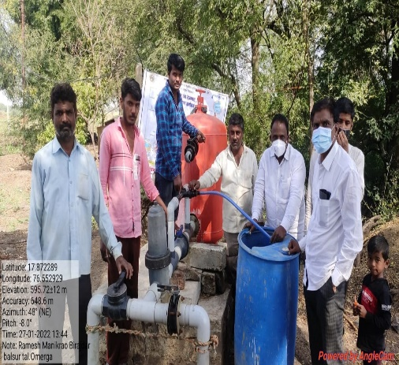
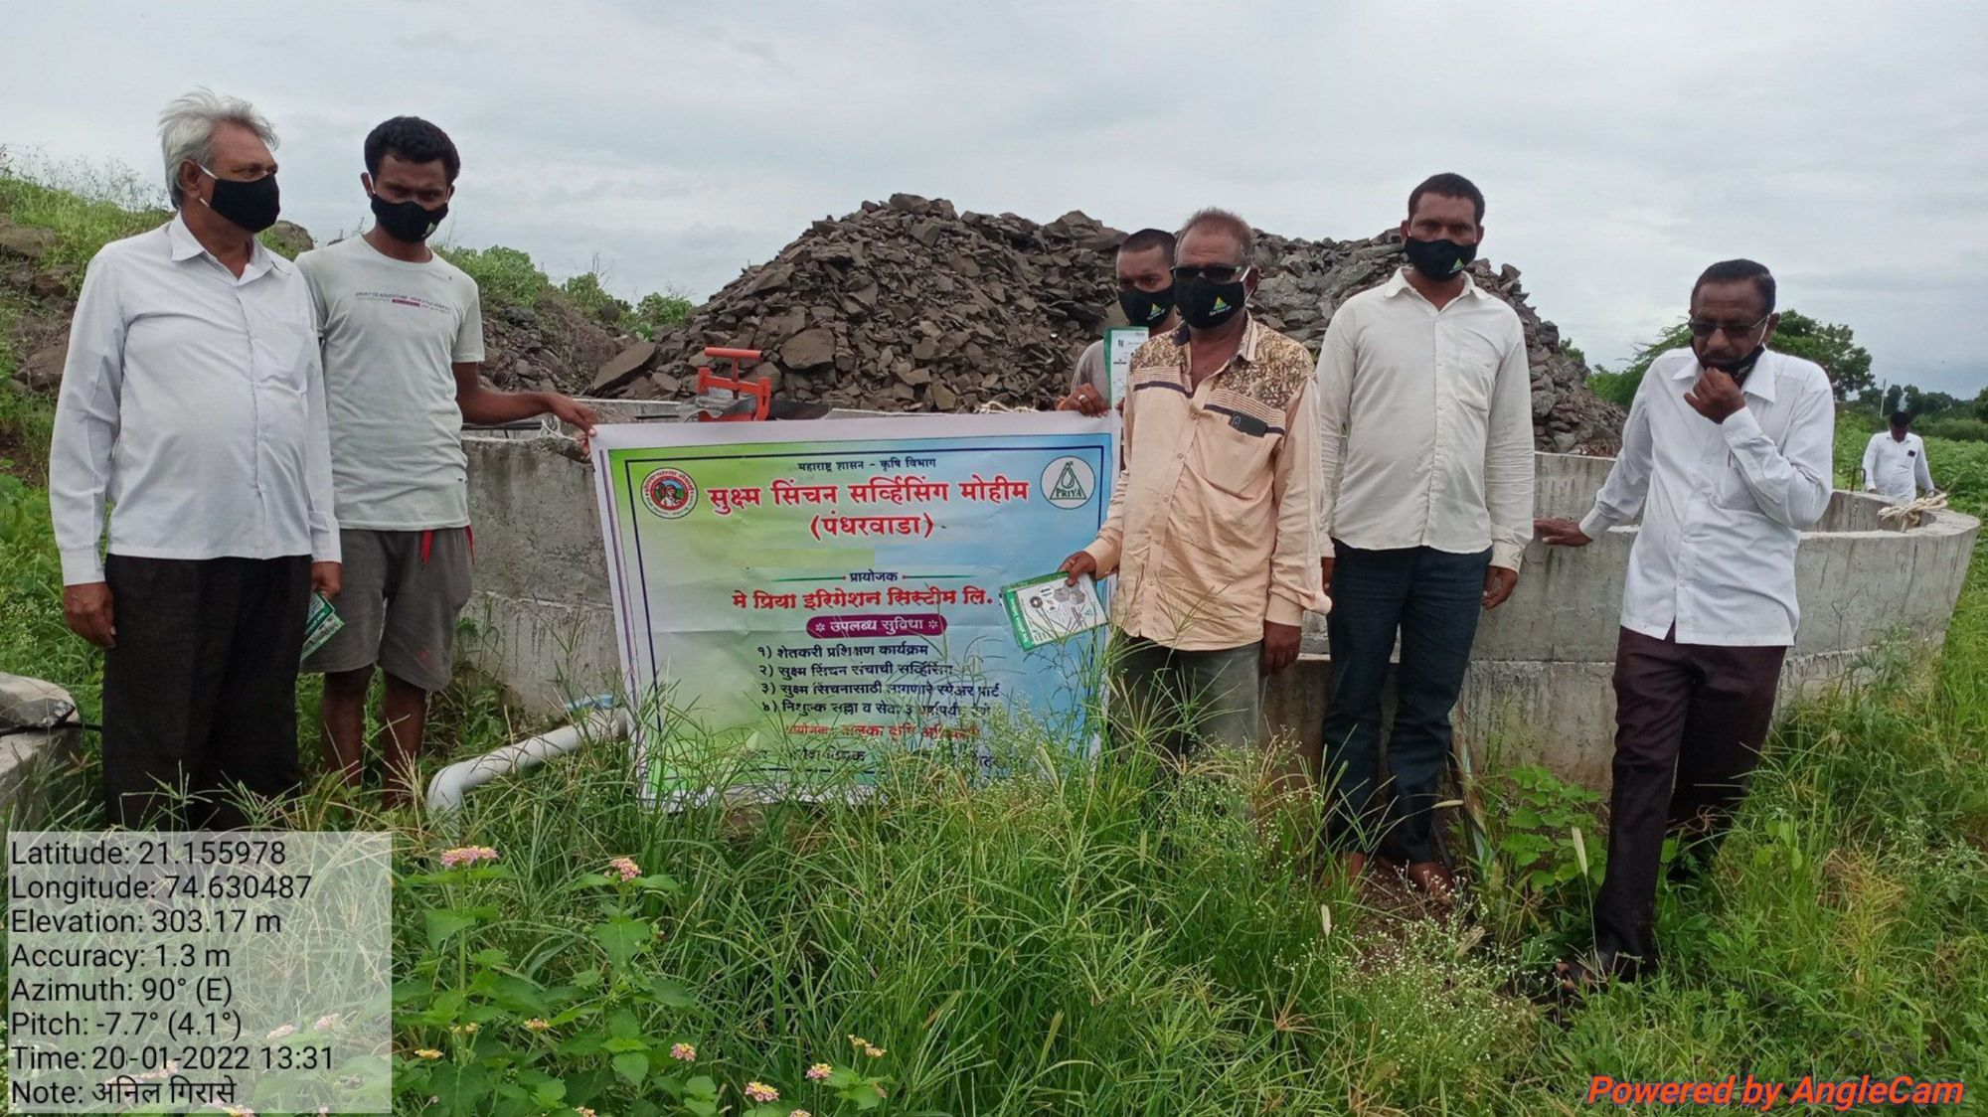
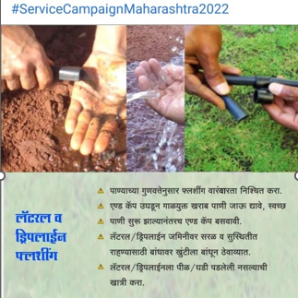
RASHTRIY KRISHI VIKAS YOJANA –PER DROP MORE CROP

Slide 23
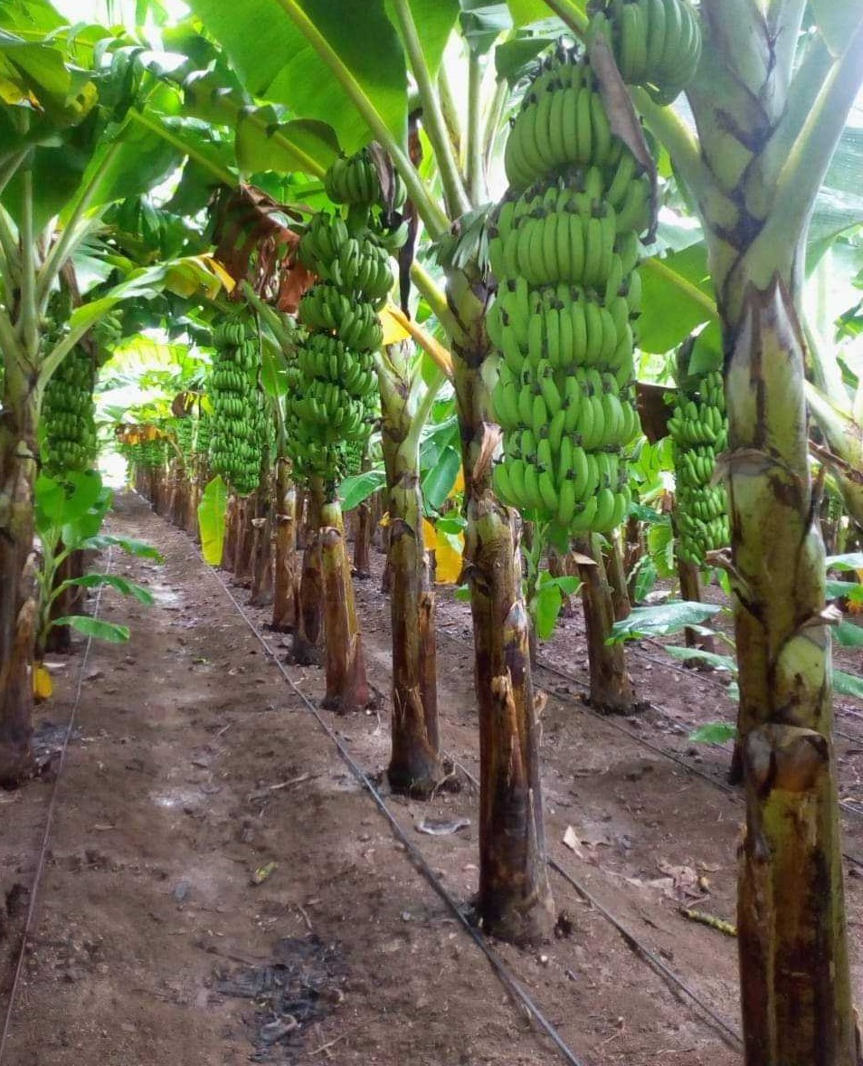
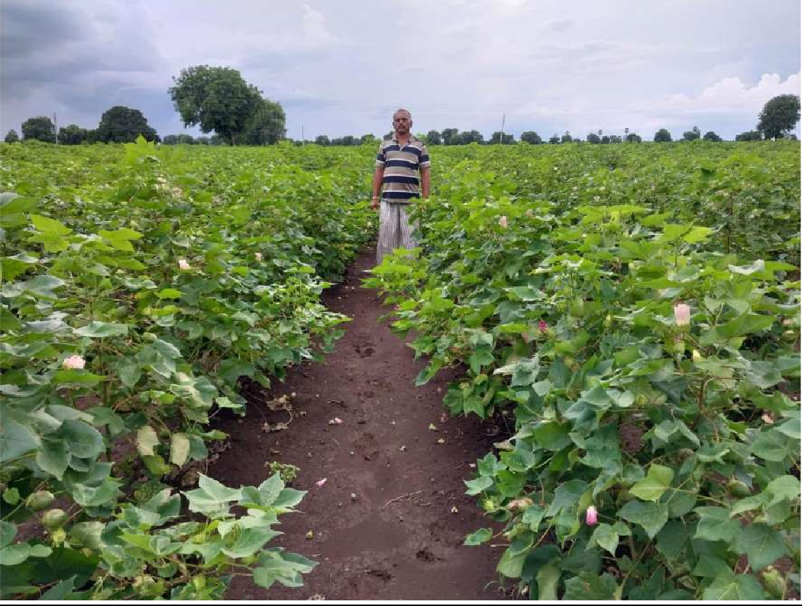
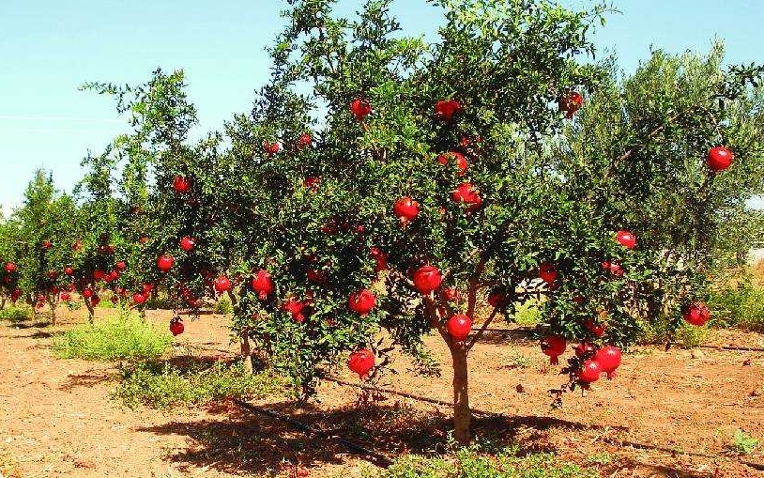
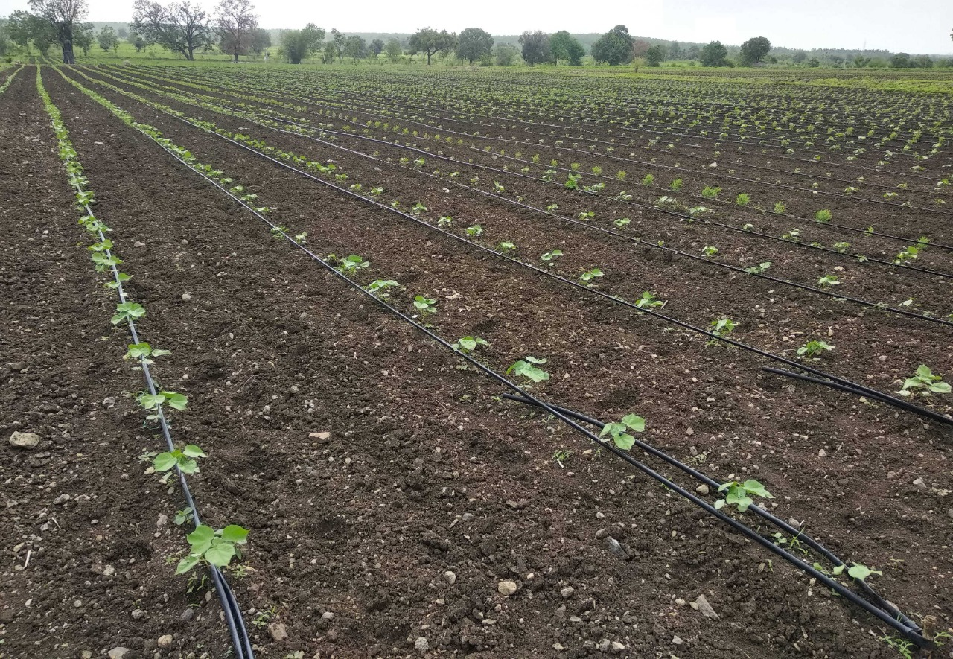
RASHTRIY KRISHI VIKAS YOJANA –PER DROP MORE CROP

Slide 24
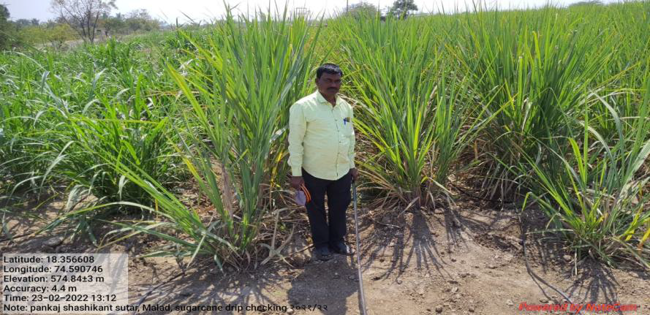
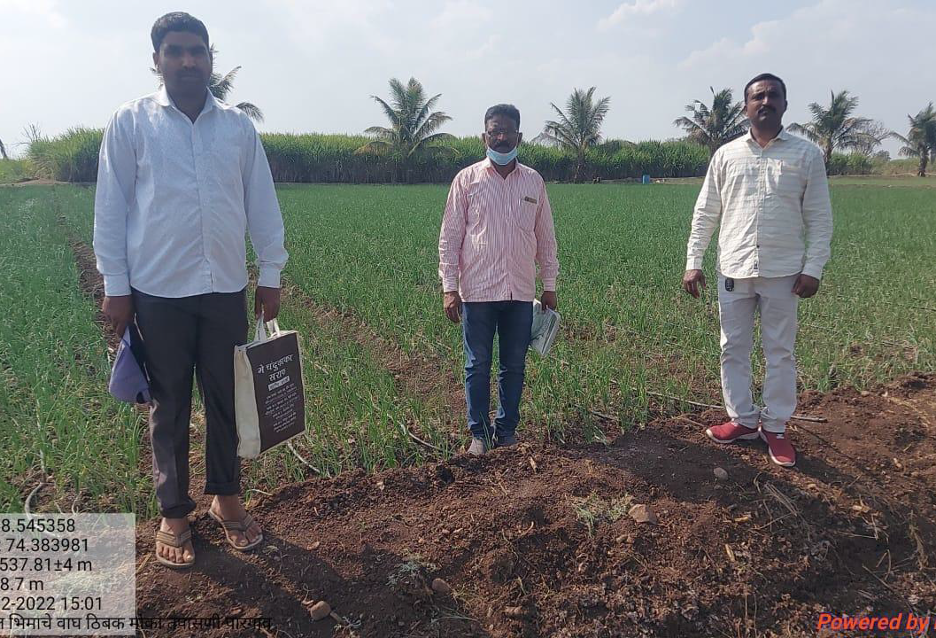
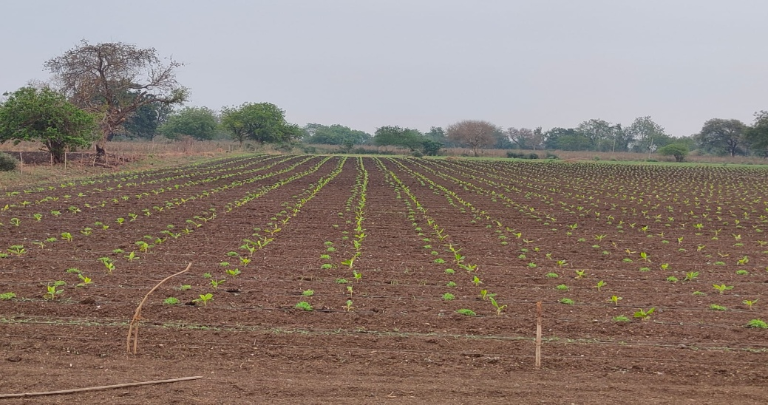
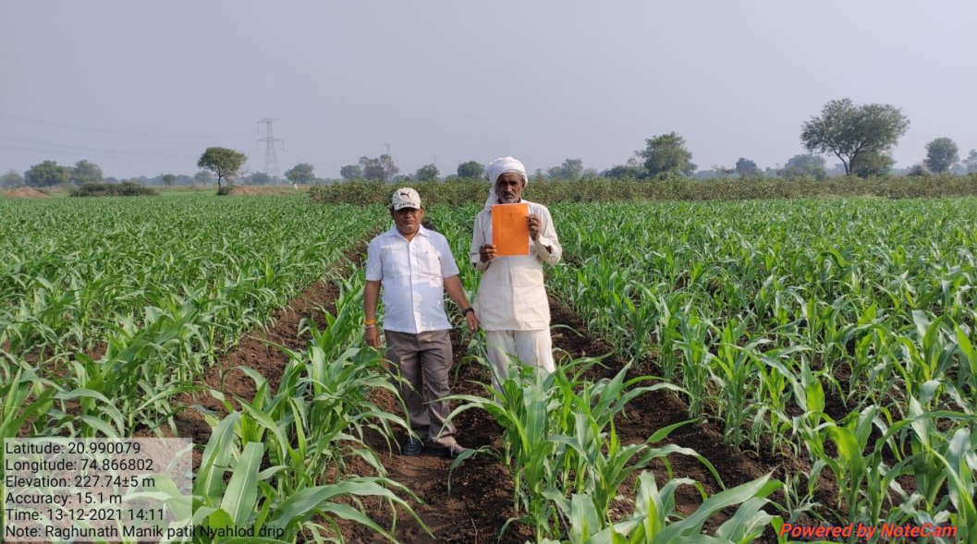
Thank You

