Slide 1

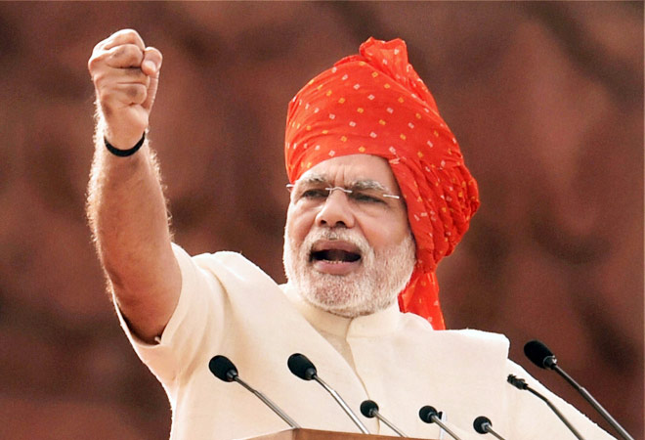
प्रधान मंत्री सिंचन क्षेत्र आधुनिकीकरण उपयोजना
PMSKAU
हर खेत को पूरा पानी

Slide 2
ISSUES OF INDIAN IRRIGATION

Slide 3
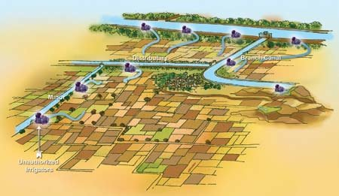
Gravity Based Irrigation
ISSUE 1
Chaotic
No Last Mile Connectivity
Poor ROI: Long gestation/ execution, Land acquisition, Rehabilitation & Soil degradation

Slide 4
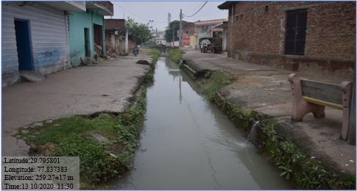
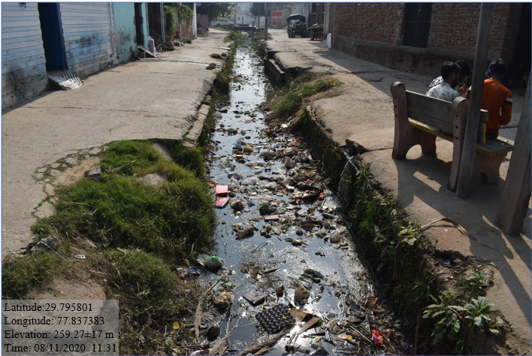
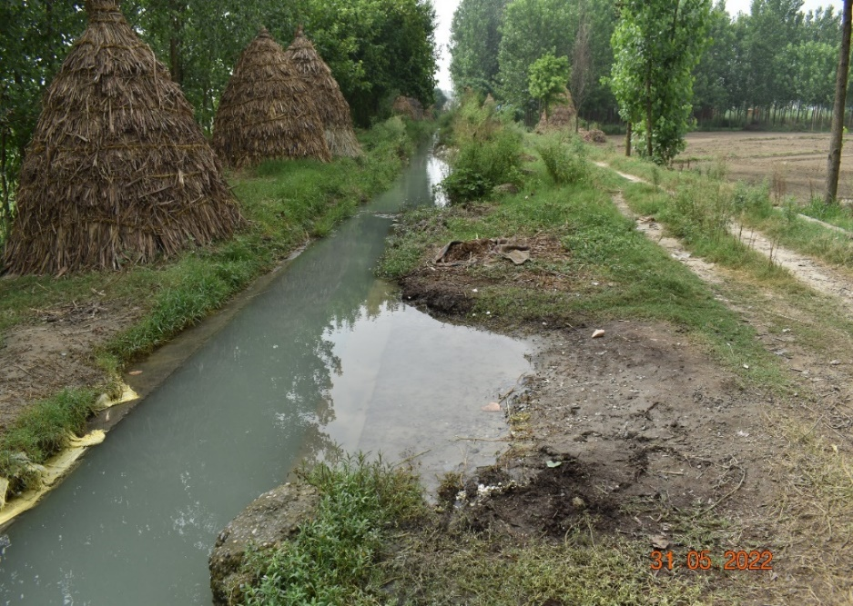
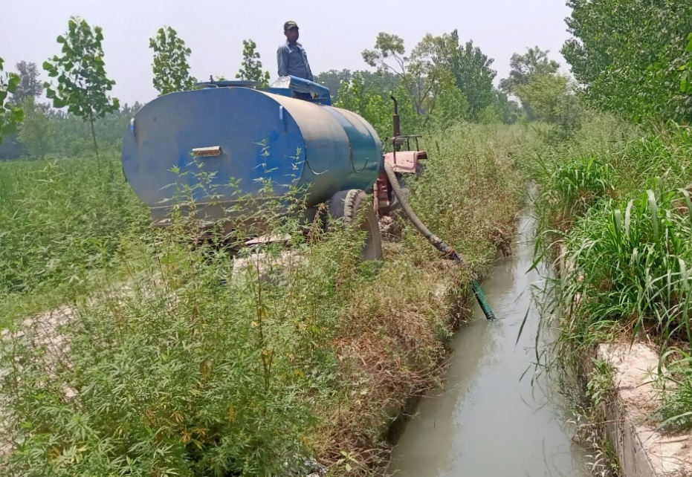
Water Governance ?
Water Use Efficiency ?
CLU : Urban Commands
Unreliability and no control in water flows
No control over timing and quantum: Supply Based Excessive use of water : low productivity, Mono Cropping
WUE 35 %
Excessive use of water : infertility of soils, Salinity and alkaline soils

Slide 5
Last Mile Connectivity is only ~50%, Room for Modernization
ISSUE 2
Plan | Irrigation Area Created Under all sources /all Projects/Schemes of Union and State Mha Source: CWC Data ( Under AIBP: AIBP Master data) | Last Mile Connectivity CCA covered under CADWM program Mha Source: CADWM Wing Master data
1951-1974 [23 years] | 44.20 | No Data
CAD Program Start (1974-75) V Plan(1974-78), Annual Plan(1978-80), VI Plan(1980-85), VII Plan(1985-90), Annual Plan(1990-92), VIII Plan(1992-97) [23 years] | 42.1 | 14
AIBP Start in 1996-97 IX Plan(1997-02), X Plan(2002-07), XI Plan(2007-12), XII Plan (2012-17) [20 years] | 27.2 (9.4) | 8.1
PMKSY Start in 2015-16- 99 projects 17-18 to 21-22 [5 years] | (1.7) | 1.1
Total | 69.3 (11.1) | 23.2 (33.47%)

Slide 6
CADWM Program : CADWM is not Infrastructure project
CADWM (Launched in 1974-75 , Restructured in 2004 as CADWM) with an objective:
  Source Independent
  Target last mile Connectivity
  Enhance water use efficiency
  Increase agricultural production and productivity
  Sustainability through Participatory Irrigation Management (PIM)
Methodology in order :
  Institutional: CADA Authorities for Multidisciplinary, integrated and well-coordinated development of Command Area
  Legal: PIM Promotion
  Non structural : Social Engineering and not Civil Engineering, to take over
  Structural: Adequate delivery system of irrigation water from canal outlet up to farmers’ fields, Water logging, Drainage, System Deficiency (4.25 cumec!!)

Slide 7

GW Based Irrigation Bubble
ISSUE 3
Water Use Efficiency with high duty ?
Solar Pumps are Always On !!
BAU is Hydrogeological Environmental threat so Unsustainable
For Better Reliability and productivity
High Income crop
All MI Government Schemes/ MI Company promote GW Use for MI

Slide 8
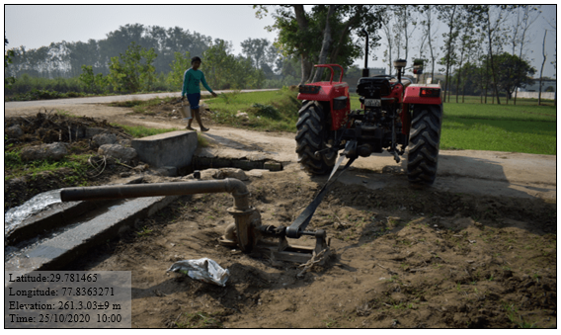
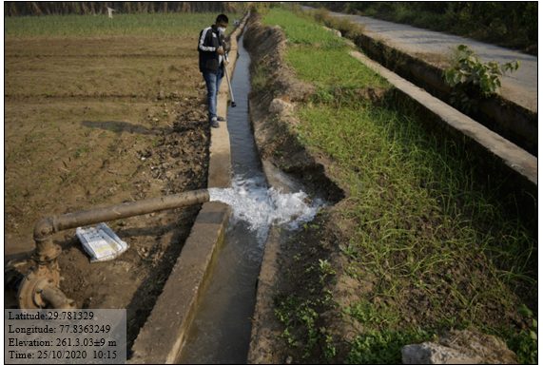
Empty Canals:
No water : Higher Food Cost
zero SW so More GW
GW Augment Canals

Slide 9

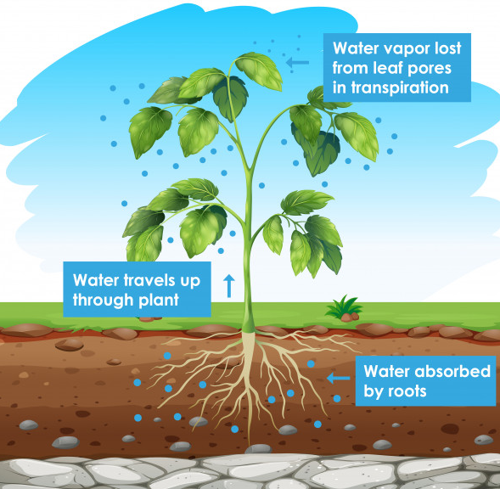
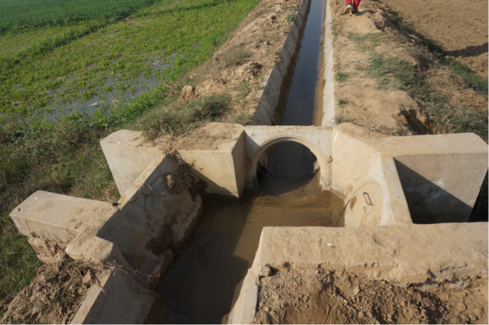
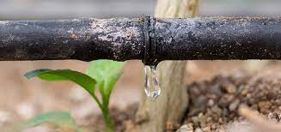
ISSUE 4
On Farm WUE
Duty under Gravity Field Channels or piped GW Irrigation 20 lps/ha.
Water is given to soil.
1 cumec= 50-100 Ha
Piped
Duty for Precise Irrigation system is 0.35 lps/ha with 25 m head.
Water is given to root.
1 cumec =2500 ha
PPIC
Δ, Duty :
Rice/ Sugarcane/ vegetables 1.29 lps/ha,
Wheat 0.55 lps/ha

Slide 10
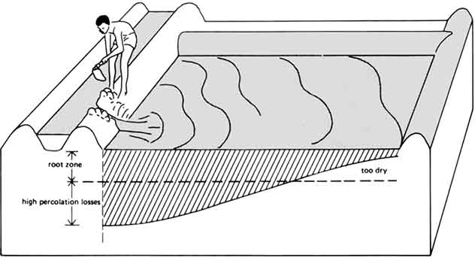
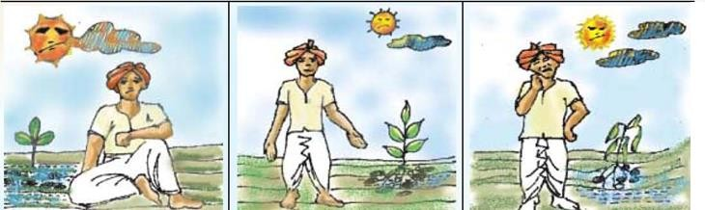
Crop productivity under Gravity Field Channels Irrigation Command
Huge Water Losses
Poor Water Use Efficiency
Low Value Crops
Farmer Education
First Three Days
Only water
No Air
Middle Two Days
Last Two Days
No Water,
Only Air
Stunted Growth

Slide 11
On Farm WUE
W_{F1}: Field Channel application efficiency which account for the intermittent supply losses in the water courses/ field channels.
W_{F2:} On Field Water application efficiency which account for the actual water not consumed by the crops.
W_{F =} W_{F1} X W_{F2}
CADWM Control
Farmer Control & Precise Irrigation
Unlined field Channels | 40%
Lined Channels | 55%
Pipe | 95%
0.95 X0.95= 0.9
Surface irrigation (border, furrow, basin) | 60%
Sprinkler irrigation | 75%
Drip irrigation | 95%
on Farm WUE up to 90% > Project WUE 55% is possible

Slide 12
On Farm Efficiency Holds the key
Current Irrigation Demand (all sources) in India 650 BCM
For a 20% conservative increase in WUE, over and above the existing 35% efficiency, will free approximately 50 BCM ( 7%) of water
Enough for Smart Cities, Environmental flows or Irrigating more land area
146 Food Basket Reservoirs has Current Water Storage of 55 BCM
No need to Create More storage structures

Slide 13

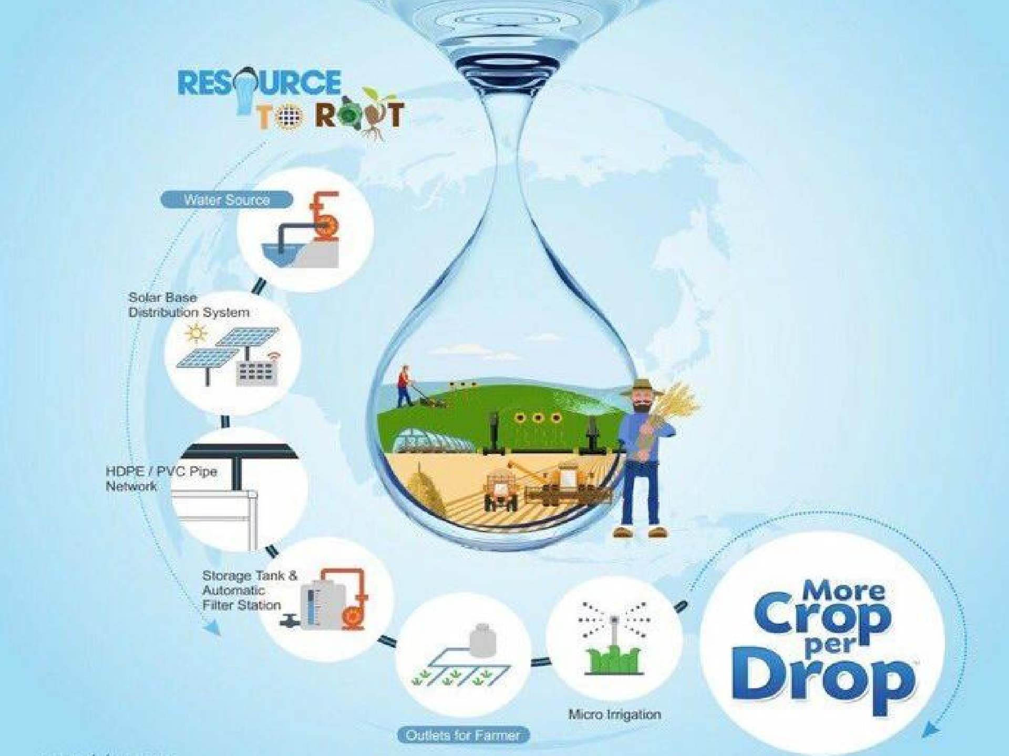
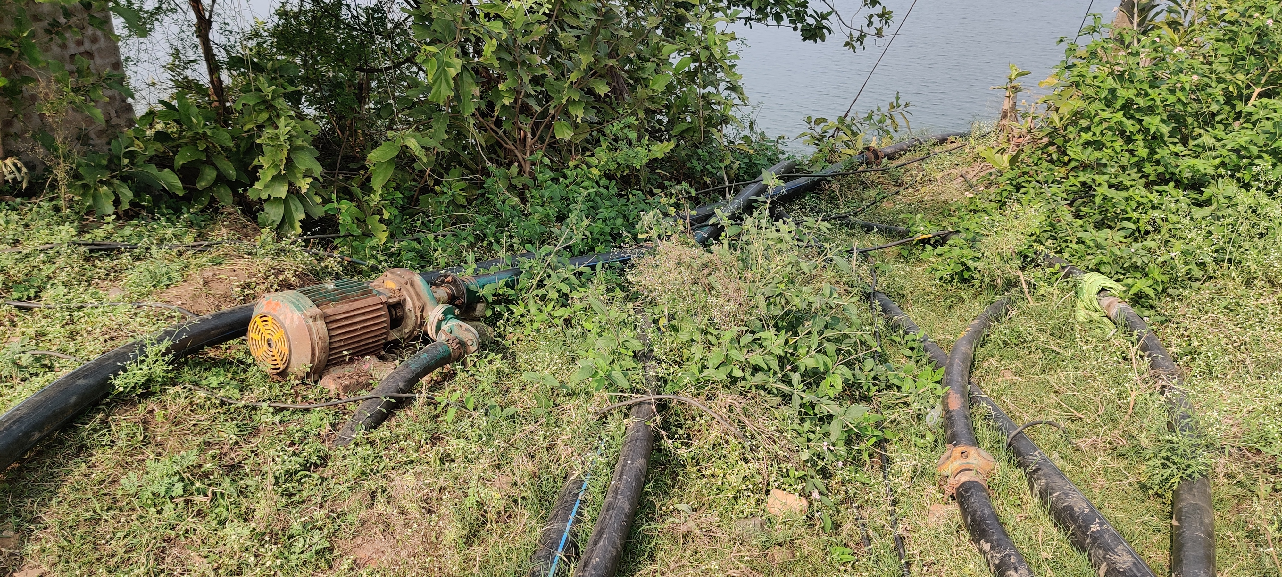
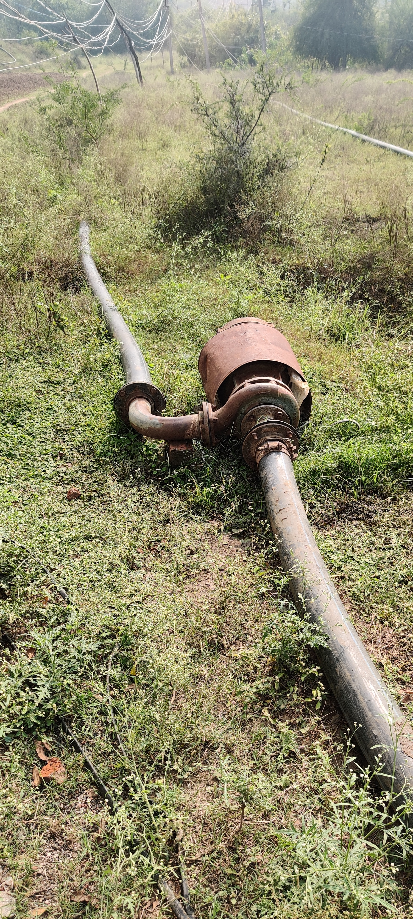

Micro-Irrigation
ISSUE 5
Frontend
Demand Side: GW Extraction
Canal
No Backend Distribution network
RKVY-PDMC
NMSA
NHM
NMEO+CDB+NBM
ATAL BHUJAL
MIF(NABARD)
RBI (Instruction on Priority Sector)
Water Governance ?
Water Use Efficiency ?
4G Handset
without 4G network

Slide 14
Arable Land
1550 Lakh ha
Irrigated Area
700 Lakh ha
Net Sown Area
1420 Lakh ha
Geographic Area
3287.3 Lakh ha
GW
420 Lakh ha
SW*
280 Lakh ha
Rainfed Area
720 Lakh ha
MI
120 Lakh ha
MI 2 Lakh ha
MI Target : 700 Lakh Ha
Current MI Coverage : 122 Lakh Ha
Rate of MI : @ 10 Lah Ha/ year
MI has 5 years retirement age
Total Coverage will require 100 years

Slide 15
GW can not fulfil India’s MI dream
Utilizable GW
240 BCM
Task Force on MI (2004)
69.5 M Ha
Water Required for the MI Target
500 BCM
Total Coverage will NEVER materialize only on GW
SW
GW

Slide 16
ISSUE 6
Irrigation Aspirations
  Focus on aspirational districts / blocks,
  Focus on border areas for developing fast food supply chain to Army in border areas,
  Creating New food basket areas in India ( support to Bringing Green Revolution to Eastern India (BGREI)
  Targeting rain fed areas
  Promoting Organic Farming
  One District One Product
To provide Food security
To provide economic security to the people dependent on Agriculture
To contribute more to the GDP
To produce raw material for Agro based Industries
To provide enough for export of the value added farm products

Slide 17
Irrigation Change in last 50 years from Engineering approach to Management Approach
ISSUE 7
Minor Canal
Micro Irrigation, Internet of things, Piped Irrigation
  Water Use Efficiency, Reuse of Treated Water, Water User Society-FPO: Agri support Services from govt.
Outlet
  Water Courses,
  CAD Works, PIM-WUA
TECHNIQUES
1975-1990
MANAGEMENT of Technology & Sustainability
2023-2033

Slide 18
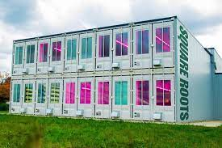
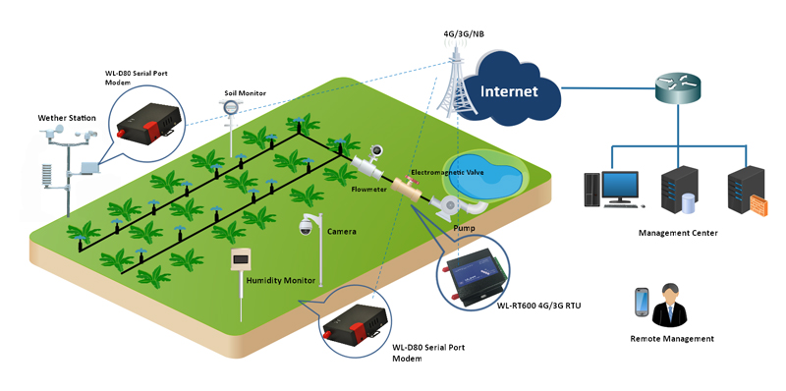
Farming today; Any time Any where Smart Irrigation

Slide 19
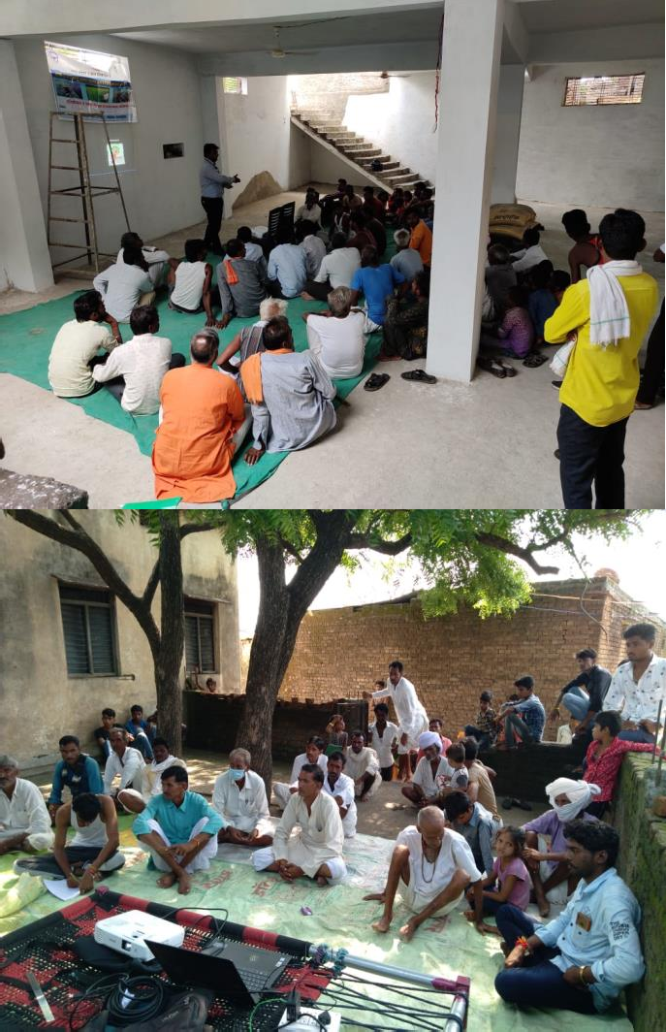
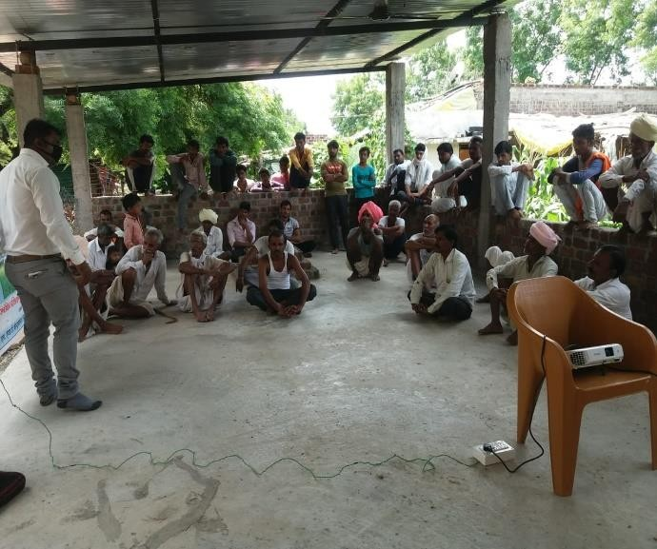
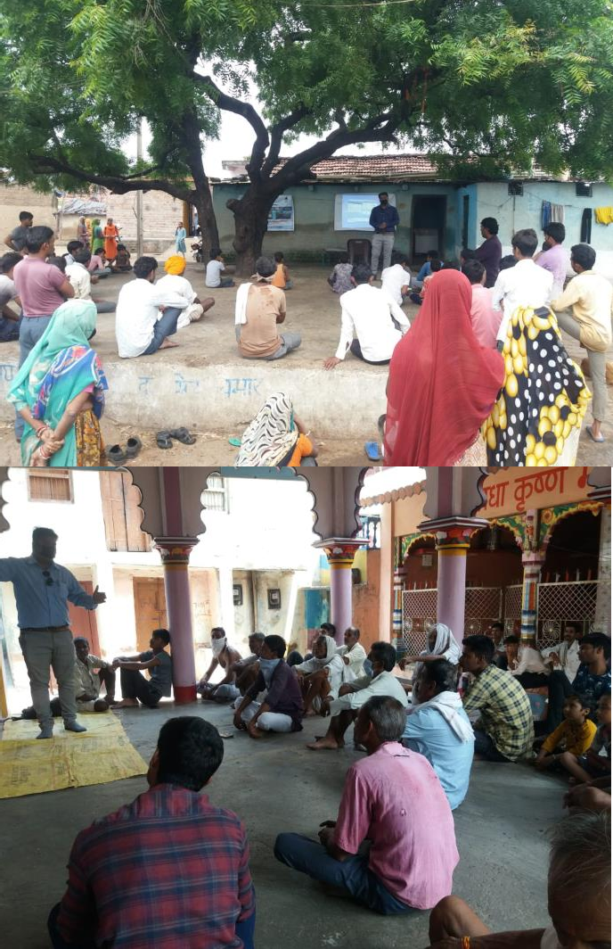
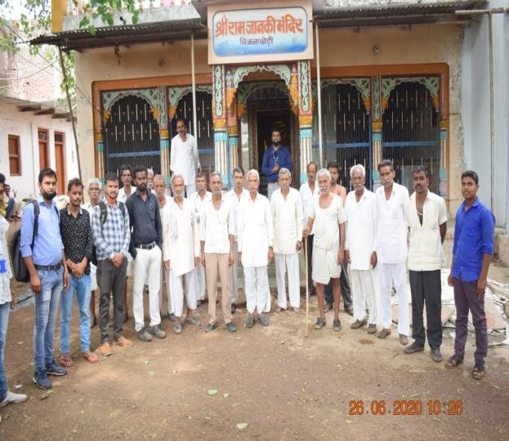
ISSUE 8
Water user as Owner: Irrigation Management Transfer/FMS/FLID:
Sustainability
Council, Committees
Capacity Building
Confidence Building

Slide 20
“After creating one DAM
you have to cross many DAMS:
Distribute, Allocate, Manage and Save ”

Slide 21
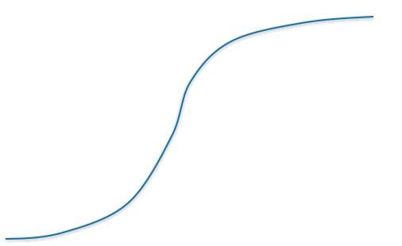
Not many Farmer Managed Systems
IMT
WUA up to 300 ha ~ 200 Farmers
Conflict Management
Equitable distribution & WUE
O&M Cost Recovery
Asset Management
FLID
FMS
PIM-WUA
low level of financing of WUAs,
lack of upgrading of the main system,
blurred/ skewed management/ business plan
lack of Education and capacity, Business Acumen
Department blank manpower & budget for R&M

Slide 22
SOLUTION

Slide 23
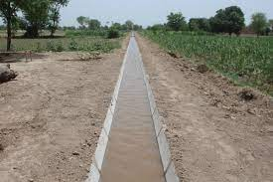
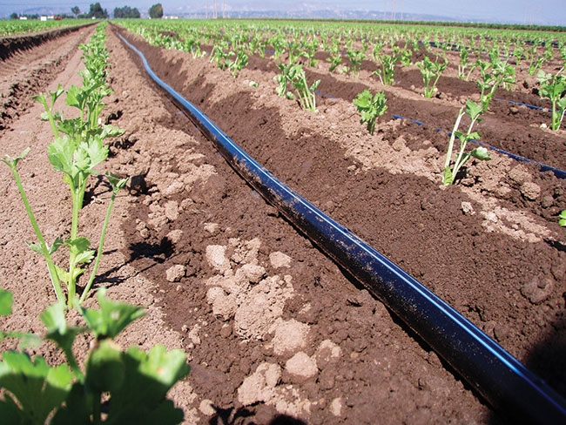


Solution
1700 Existing MM Irrigation Systems with ~50 % Gap in Last Mile Connectivity
GW extraction to be lowered
MI should work on SW for 71 M ha
100 ha to 5000 ha Modules
Pressurized Piped Irrigation Network in the Command from Established source to Farm Gate below Minor Level Network Readiness for Farmer to adopt Micro Irrigation in the Farm On Farm Water Use Efficiency up to 90%
For Governance & Sustainability : Irrigation Management Transfer/ Farmer Led Irrigation Development / Farmer Managed Systems

Slide 24
Modernization of irrigation Command
PPIC
Irrigation Management Transfer
Below Minor Level
Up to 5000 ha module
Below Minor Level
Up to 5000 ha Module

Slide 25
Water User Society
Society Act 1860:
2 Board member from each 300 ha hydraulic unit RMS
1 Council member from 30 ha OMS
State Govt Departments
Central Government Technical Support
Executive Board
Council
Professionals Support
Farmer Relationship Organization
Office Staff
O&M Service Provider
Waghad Nashik Story
Efficiency
Decentralization
Sustainability
Individual Members
FPO/ Economic Entity
Agriculture Universities, Stations

Slide 26
Sense of Ownership
Water User Society (WUS) up to 5000 ha ~ 3000 Farmers
﻿Federalizing WUAs
Sense of ownership
Independent from Government Control
Large Resources for management of irrigation system
Sustainability of Projects
Active representation participation of the beneficiaries the irrigation systems
Capable of maintaining, Modernizing irrigation systems both technically and institutionally
Capable of Farmer welfare, Economic Activities, benefits of all Govt. schemes
Managing groundwater use,
Opting for public-private partnership
Capacity Building of the members
Better linkage with WR & other Department officials

Slide 27
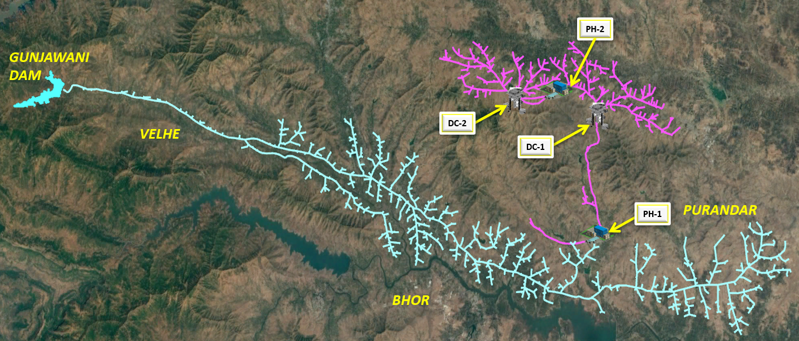
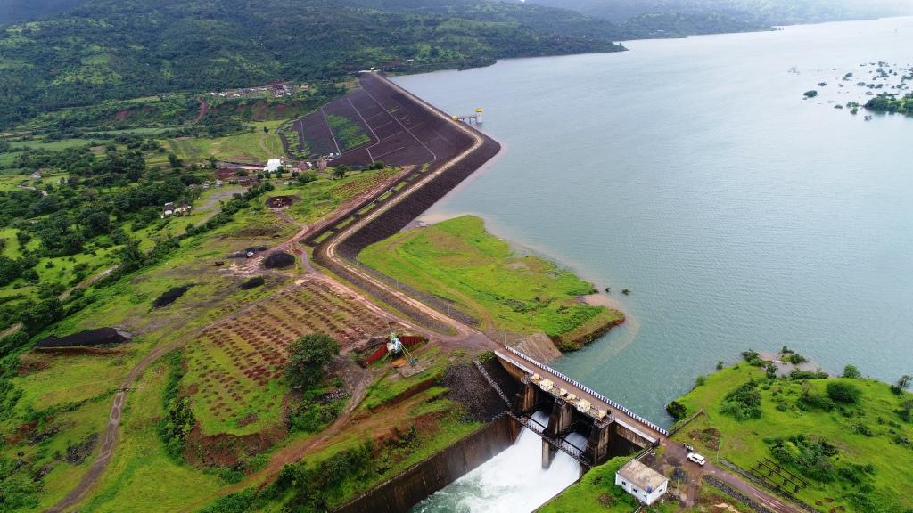
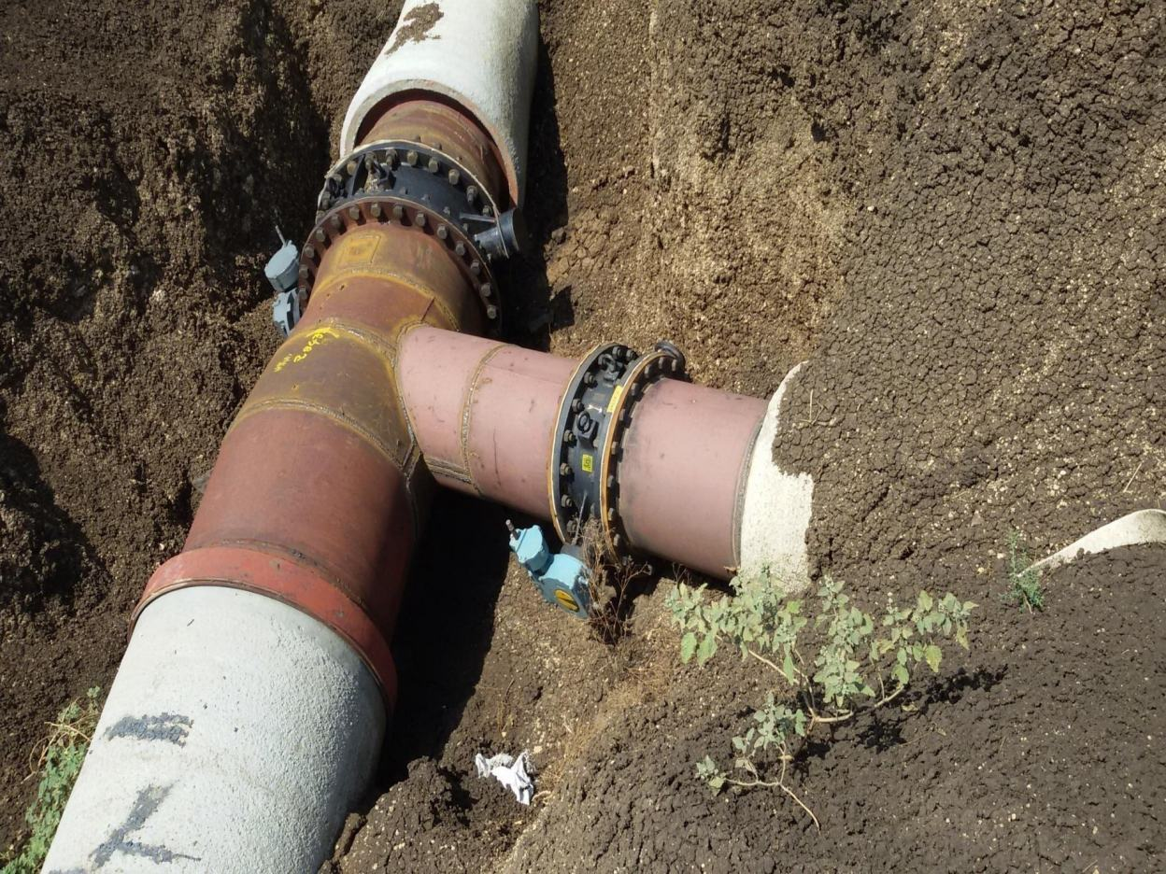
Existing
SMI, GW
Existing Dam & Canal
Minor & FC Converted
to pressurized Piped Network
Conversion of Tertiary Network into
Pressurised Pipe Irrigation Command
Existing Gravity Irrigation Network of
Main Canal and Distributary

Slide 28
Expansion of Command
Distributary
MC2
2
1
GW/ Treated Water
MC1
2
4
1
3
4
SMI
3
Creating Pressurized Pipe Irrigation Command below Minor level

Slide 29
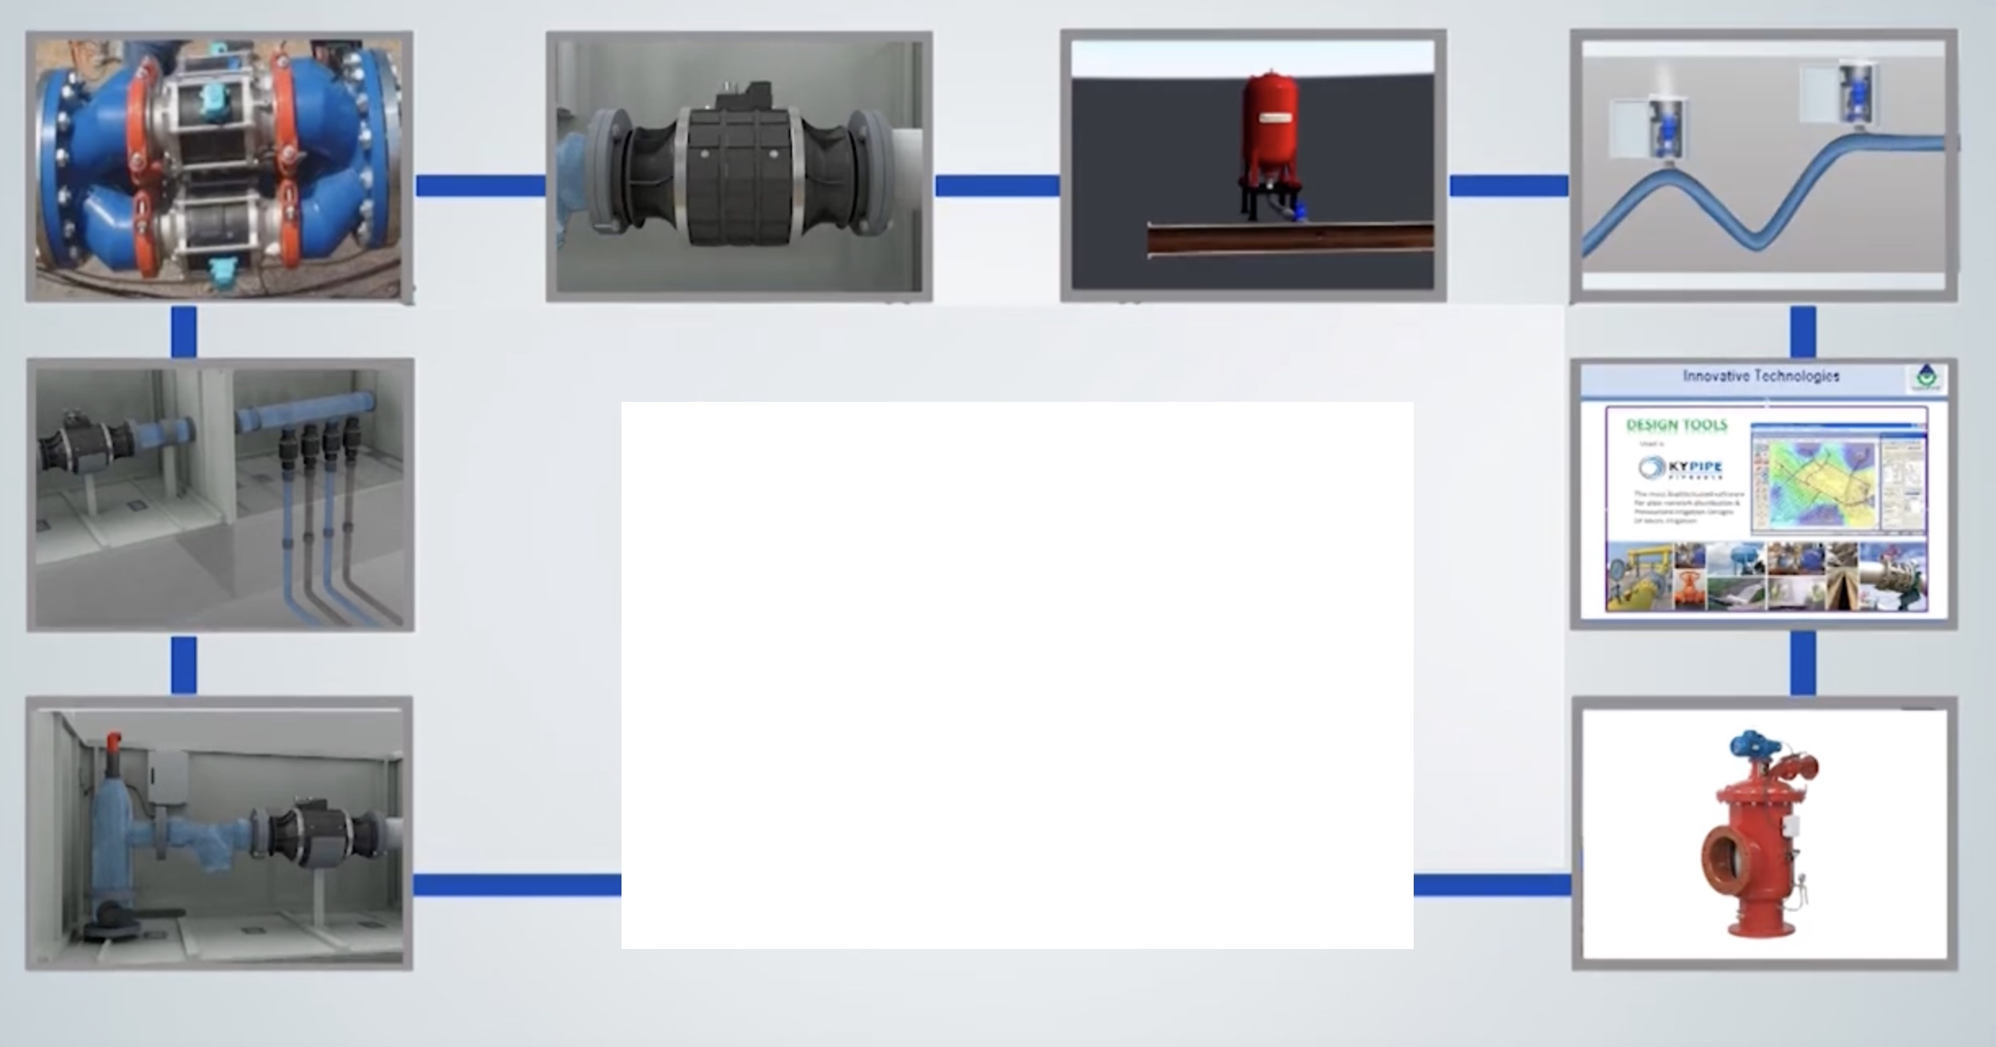
Pump Station
Pipelines
Filter Unit
Air Management System
Scour Valve
Remote Management System 300 ha
Outlet management system 30 ha
PCFMD 5 ha
Flow Outlet 1 ha
GPRS Communication
SCADA Controls
Software & App based Controls

Slide 30
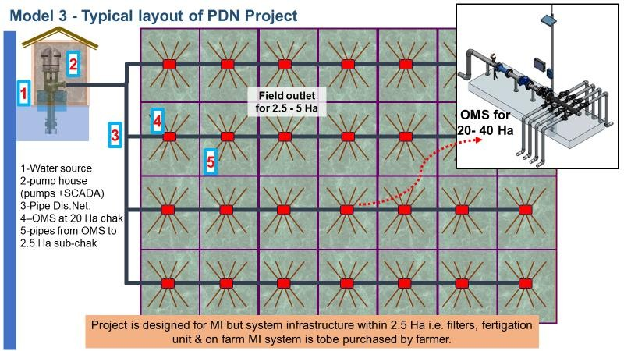
Convergence for Success of Micro-Irrigation on SW
1
I&D Deptt. lays main and submain pipes+ Assures Water & Electricity
2
Farmer require micro-irrigation (incentivized/subsidized) – Drip irrigation or sprinkler irrigation through PDMC/ MI/RBI-Bank Loan/NMSA
20-30 Ha. chak
CONVERGENCE !!
CADWM Wing of MoJS with
RFS/RKVY/NRAA Wing of Min. of Agriculture

Slide 31
प्रधान मंत्री सिंचन क्षेत्र आधुनिकीकरण उपयोजना
PMSKAU

Slide 32
WUE Impact Analysis
Overall Savings in GW | Enormous
MI on SW | Ready
On Farm WUE | From 45% to 90%
Savings in Water for target of 2.25 Lakh ha @ 0.40 m Δ saving | 0.9 BCM

Slide 33
Social Impact Analysis : Quick results
Impact on the State Departments | Water Delivery Service Departments Collection of the O&M – Volumetric basis No Maintenance Budget No Maintenance manpower Focus on new deployments/ Water Management Water Fee Collection
Impact on Farmers | Har khet ko Pura Paani Metering of water Higher farm productivity and higher farm incomes Area under high-value crops, larger range of cash crop Improved Reliability of Water availability Increase in Irrigation intensity and cropping diversification
Impact on Rural Economy | Farmer led irrigation Development Empowered association can take all benefits of all GOI schemes and take up all Economic activities Social Assets creations New Business Environment Creation for the future Rural IT Jobs creation
Impact on Central Government | Accurate Data collection for policy Analysis Boost to all ambitious Schemes of Ministry of Agriculture, Rural Development, PRI, MNRE

Slide 34



Issues that will be addressed in PMSKAU
BWUE 20%
RKVY-PDMC
NMSA
BGREI
Rural Economy
Self Help Groups
Solar Mission
Local Jobs

Slide 35
Key Requirements for Success of this Scheme
Survey-Design
Proposal
State Budget
PPP Partner
PPP Partner
3 or 4 Party Agreement
PPIC development Funds
Convergence of various schemes of Govt. of India
Handover to Water User Society to Manage O&M
Annual Auditing of Performance of WUS
Work Execution
Social Monitoring
Social Consultant
4000
3000
2000
1000
0
5
States
MoJS
4
On Farm Education - Farmer Readiness for Micro irrigation, Order for Mandatory MI in PPIC Commands
Formation of Water User Society for the benefitted Command
Electric Line 11 KVA
Assured Water Source
3
2
1
You can insert graphs from Excel or Google Sheets

Slide 36
 |  |  |  |  |  |  |  | Year 2
 | 1 | 2 | 3 | 4 | 5 | 6 | 7 | 8 | 9 | 10 | 11 | 12 | 13 | 14
Formation of Water User Society
Survey Planning of Pipe Network |  |  |  |  |  | ◆
Electric Line & water Availability
Ident ification of Water Manager, Nodal Department, Budget & Convergence |  |  |  |  |  |  |  |  |  |  | ◆
Approval , MoU & Funding |  |  |  |  |  |  |  |  | ◆
Farmer Relationship
Execution
IMT Handover
State’s
Home work
Year 1
Quick Results

Slide 37
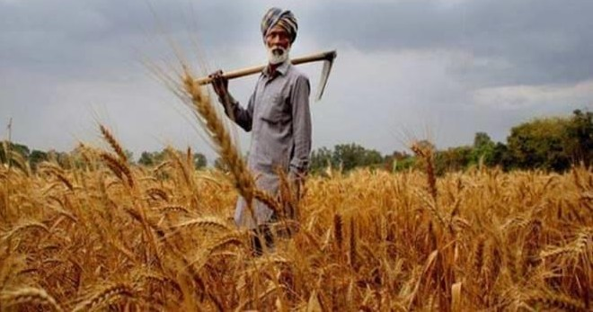




Welcome the Amrut Kal of Command Irrigation

