Slide 1
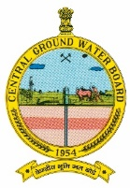
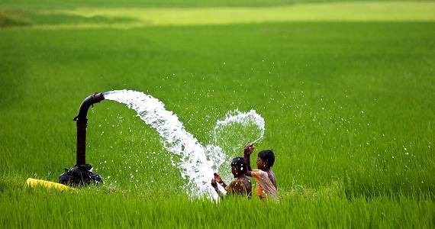
Govt of India
Ministry of Jal Shakti
Department of Water Resources, River Development and Ganga Rejuvenation
CENTRAL GROUND WATER BOARD
Sustainable Use of Groundwater
Per Drop More Crops
National Workshop
31st May 2023
Thakur B. N. Singh
Member (East)

Slide 2
2

Slide 3
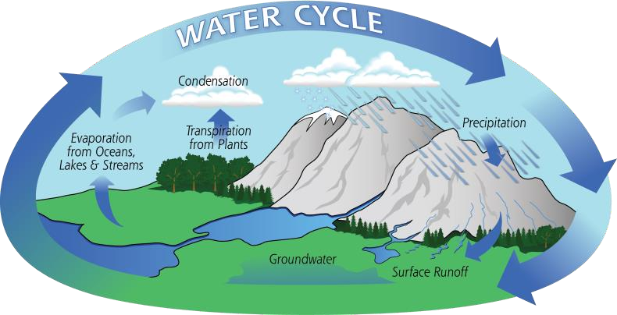
437 BCM
GROUND WATER OVERVIEW
398 BCM
239 BCM
60 %
Total annual ground water recharge
Annual extractable ground water resources
Annual Ground Water
extraction
Stage of Extraction
*Dynamic Ground Water Resources of India,2022
3

Slide 4
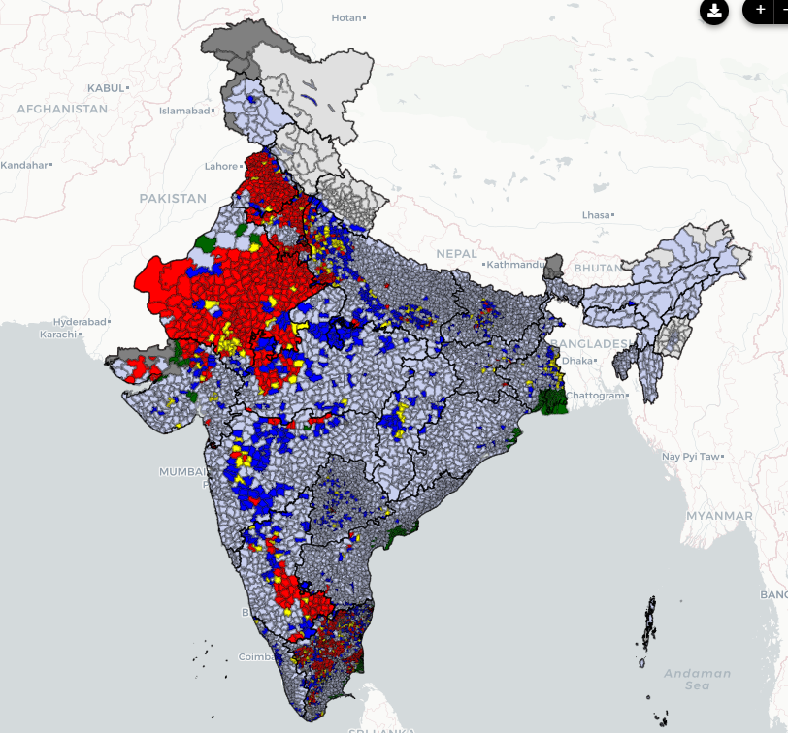
Groundwater Resources of India 2022
Categorization of Groundwater Resource Assessment units
Total Assessment units | 7089
Over exploited | 1006 (14 %)
Critical | 260 (04%)
Semi-critical | 885 (12 %)
Safe | 4780 (67 %)
Saline | 158 (02 %)

Slide 5
GROUNDWATER USE IN AGRICULTURE
Increasing Stage of GW Extraction
India has over 20 million irrigation wells
0.8 million are being added every year.
Every fourth cultivator owns an irrigation well.
Non-owners depend on groundwater markets.

Slide 6
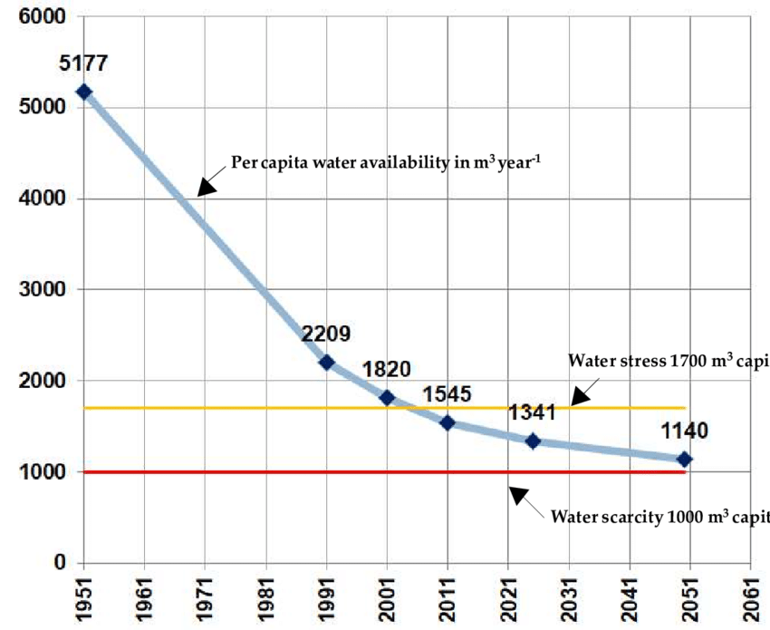
SUSTAINABLE USE OF GROUNDWATER
The sustainable use of Groundwater refers to the responsible and efficient management of this valuable resource to ensure its long-term availability
Per Capita Water
Availability in India
Per Capita Water availability in m³/year
Water Stress 1700 m³ year⁻¹
Water Scarcity 1000 m³ year⁻¹

Slide 7
GROUND WATER USE Existing demands and Issues
Deterioration in Ground Water quality
Groundwater table declining in many states
Growing demands for Agriculture,domestic and industrial water supply
Gap in demand and supply of water resources increasing

Slide 8
MISMANGEMENT OF GROUNDWATER
High water wastage
Poor maintenance of pipelines and related leakage issues.
Lack of water saving awareness.
Unauthorized tap connections

Slide 9
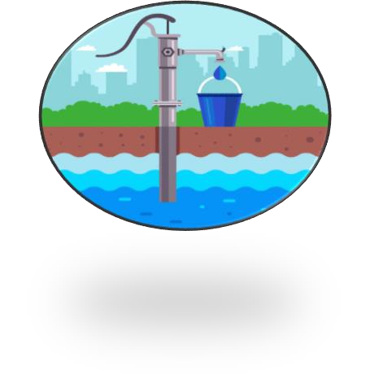
SUSTAINABLE USE OF GROUNDWATER -OPTIONS
Supply-side Management
Supply-side sustainable use of groundwater works by Increasing the amount of available water.
Demand Side Management
It works on Reducing the amount of water that is being used by stakeholders for its need.
Ground water

Slide 10
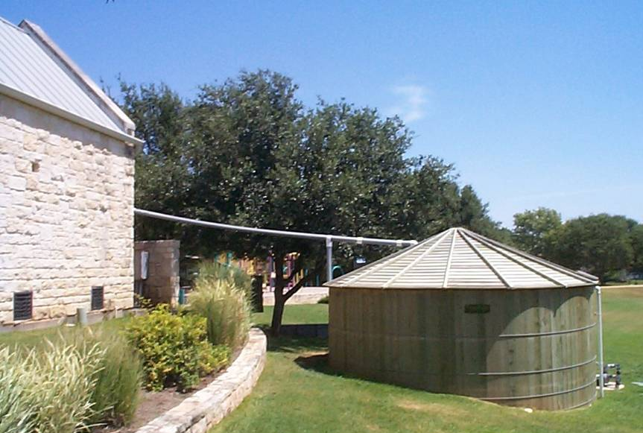
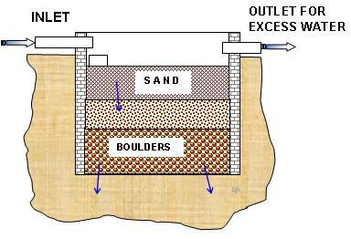
Supply Side Management
Rainwater Harvesting and
Artificial Recharge to Groundwater
Rainwater Harvesting
Artificial Recharge
Collection and storage of Rainwater
Restricting Run off
Accelerate or induce the process of infiltration by artificial means
Infiltration depends on
Nature of the top soil (infiltration Capacity)
Nature of the Rock (Permeability)
Retention Time
Contact Area

Slide 11
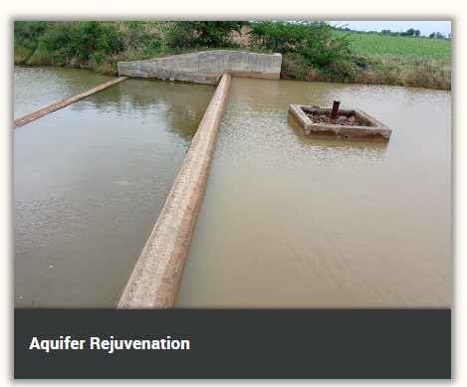
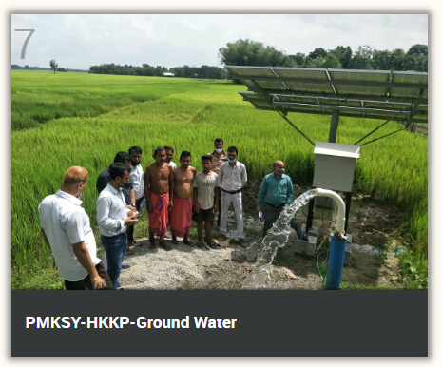
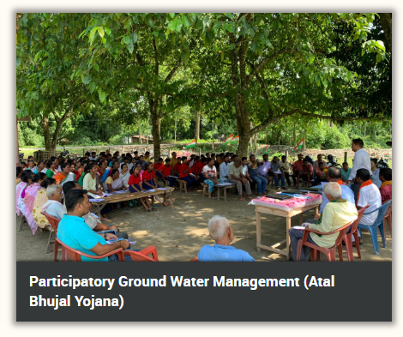
Supply side interventions and water conservation measures through demonstrative projects – CGWB
Aquifer rejuvenation projects in water stressed districts
Master Plan for artificial recharge
Aquifer rejuvenation projects in aspirational districts
Innovative instream storage - Bridge cum Bandhara
SOP on source sustainability

Slide 12
Demand Side Management
Domestic sector
Increasing Water use efficiency
fixing leaky systems or upgrading existing infrastructure to reduce wastage
Water Pricing /Water cess
Water meter
Dual pipe Water supply
Agriculture sector
Water use efficiency through drip/sprinkler irrigation
Conjunctive use
Less water consuming crops/Crop Rotation
Setting up Water User association
Grey water use for irrigation
Industrial sector
Adopting water saving technology
Recycle and reuse of water in industrial process
Capacity building and Public awareness
Ground water Regulations
Regulations, water charge, penalty and EC
Desalination of saline water

Slide 13
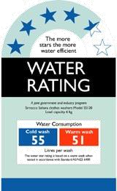
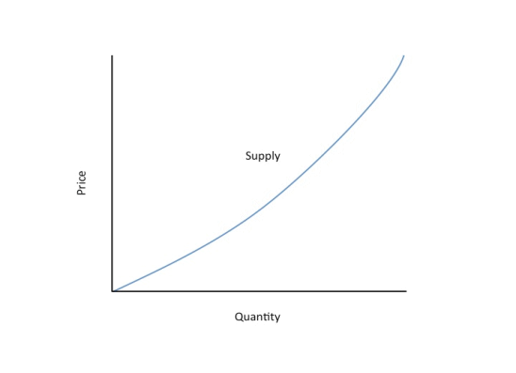
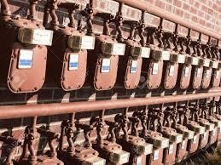
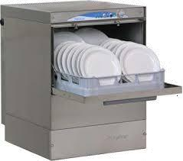
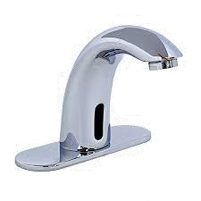
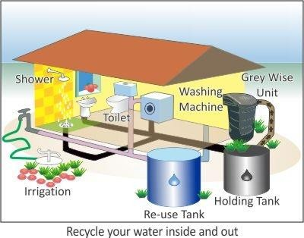
Sustainable Use of Groundwater options
Decrease water demand
Increase water source
Meter water use
Recycle and Reuse
Sensor based efficient showers
₹
Water efficiency rating
Price water as per use
Water metering
Use dish washers
Automatic faucets

Slide 14
SUSTAINABLE USE OF GROUNDWATER -OPTIONS
Recycle and Reuse
Greywater is wastewater from non-toilet plumbing systems such as hand basins, washing machines, kitchen, showers and baths.
Can be treated and reused instead of discharging out.
Reusing grey water can decrease groundwater extraction.

Slide 15
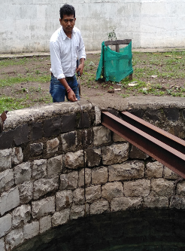
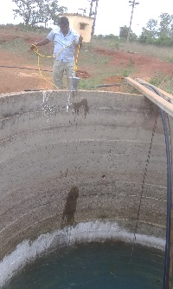
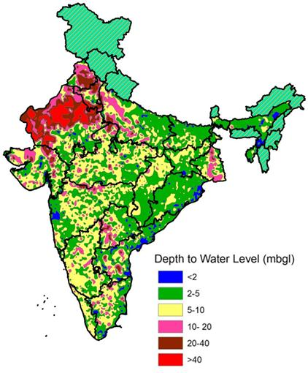
ROLE OF CGWB
Monitoring & Assessment
Strengthening and automation of groundwater monitoring network taken up
By 2026, CGWB plans to install 9000 automated monitoring stations with the telemetry system
Under the National Hydrology Project, 5260 DWLRS with telemetry is being installed.
Annual Groundwater Resources assessment is being carried out

Slide 16
CGWA and Groundwater Regulation
Through Gazette Notification dated 24th Sept 2020, Central Ground Water Authority (CGWA), for issue of NOC, has introduced the following measures for Regulation in groundwater use by industries/ infrastructure/ mining sectors:
Impact Assessment Report
All industries drawing GW of > 100 m3/day in OCS areas
Annual Water Audit Reports
by industries abstracting GW > 100 m3/day by FICCI, NPC, CII
RWH
As per model building bye-laws.
GW Charges, Penalty, EC
As per specified rates
All industries shall be required to adopt latest water efficient technologies so as to reduce dependence on ground water resources (by at least 20% over the next three years)

Slide 17
CGWA and Groundwater Regulation
Agriculture Sector: Agriculture sector is exempted from obtaining NOC for GW extraction with views of-
Adopting Participatory approach for sustainable GW management
Review free/ subsidized electricity policy to farmers
Bringing suitable water pricing policy
Working towards crop rotation/ diversification/ other initiatives to reduce over-dependence on groundwater.

Slide 18
NAQUIM and Aquifer Management Plan
CGWB has carried out National Aquifer Mapping (NAQUIM) in the country and has suggested Aquifer Management Plans (AMP) for the districts.
The NAQUIM outputs and the AMPs have been shared with the district authorities for implementation.
Management Plans are being used for preparation of water security plans under Atal Bhujal Yojana
Under PMKSY-HKKP-GW scheme, the concerned departments in states, especially NER states are using CGWB findings for planning groundwater based irrigation schemes.

Slide 19
Thank You

Slide 20
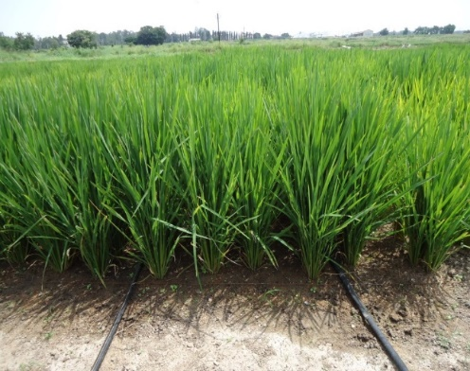
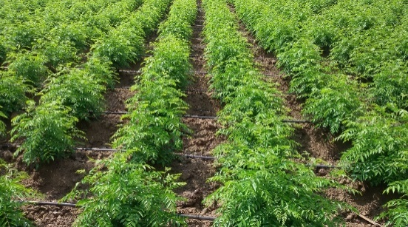
Water Use Efficiency in Agriculture
Direct Seeded Rice (DSR)
System of Rice Intensification in rice(SRI)
Popularizing Micro Irrigation (MI) techniques
Use of MI even in water-intensive crops with more focus on Sugarcane & Banana
Other interventions like Pipe carrying water from source to field to avoid seepage
Selection of low water-intensive crops
Change in cropping pattern

